Slide 1
Slides To accompany Peace Literacy Curriculum©️ The Constellation of Peace Part 1: The Power of Ideals available at peaceliteracy.org Prepared by Paul K. Chappell and Stephanie Clapes
peaceliteracy.org
Notes:
Image from Artist Unknown

Slide 2
Part 1: The Power Of Ideals
peaceliteracy.org
Notes:
Image from Artist Unknown

Slide 3
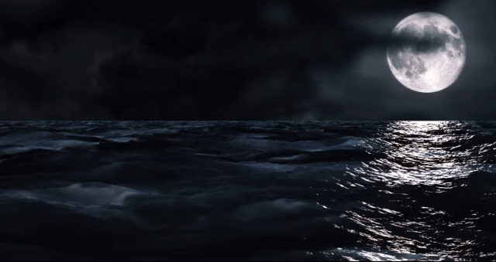
peaceliteracy.org
Notes:
GIF of https://www.youtube.com/watch?v=V15CP_9QzM0

Slide 4
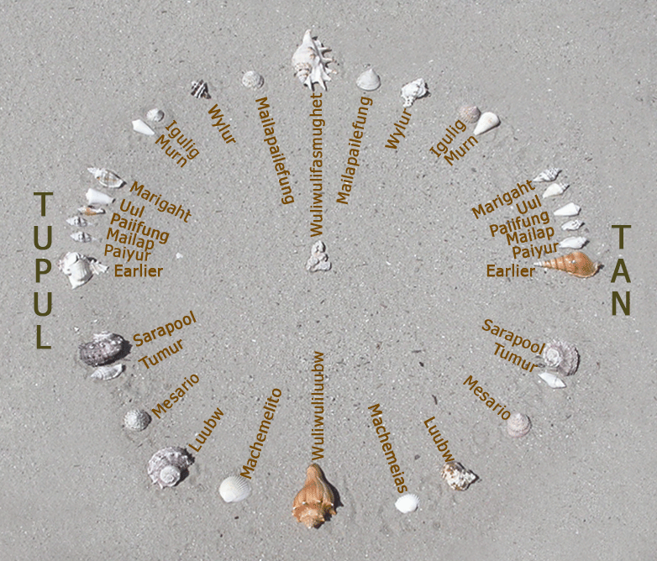
The indigenous peoples of oceania were some of the first known explorers to navigate across vast ocean distances Using the Stars to chart their course.
peaceliteracy.org
Star compass depicted with shells on sand,
by contemporary Micronesian navigator Mau Piailug, written in Satawalese.
Notes:
Image on right from https://www.startalkradio.net/show/the-stars-that-guide-us-with-nainoa-thompson/
Image on left from https://www.ralspace.stfc.ac.uk/SiteAssets/001_CTM_Welcome_ASC2018.pdf

Slide 5
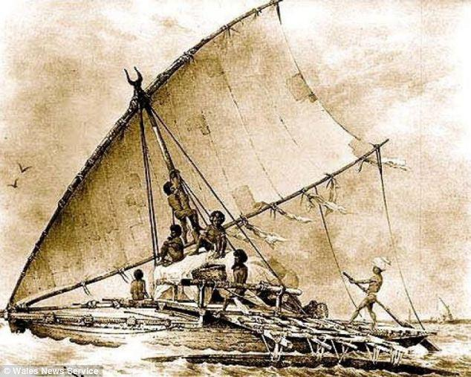
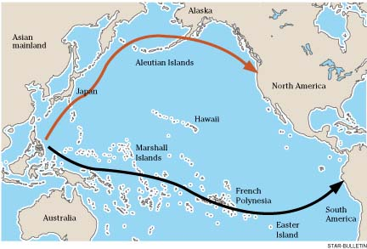
Many years before European explorers sailed across the Atlantic Ocean, the Indigenous Peoples of Oceania journeyed in double-hulled canoes on the Pacific Ocean, crossing far greater distances, in far smaller craft.
peaceliteracy.org
Notes:
Background image from https://www.ralspace.stfc.ac.uk/SiteAssets/001_CTM_Welcome_ASC2018.pdf
Image on left from https://yousense.info/686973746f7279/history-of-boats-and-ships-history-and-timelines.html
Image on right from https://www.timetoast.com/timelines/early-man-93f9f7c1-ac26-40d3-adc8-d1cd60dfacb5

Slide 6
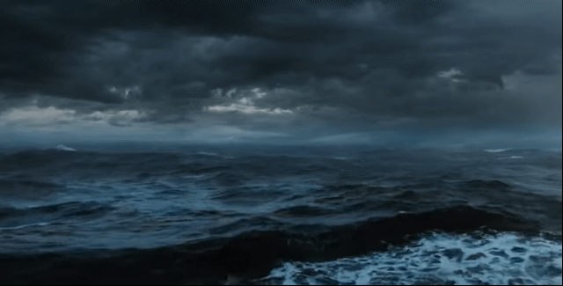
peaceliteracy.org
Notes:
GIF of https://www.youtube.com/watch?v=AsD5u6k6dKI

Slide 7
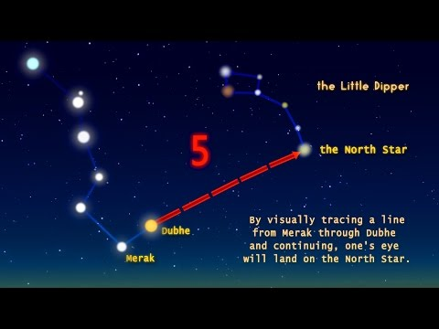
peaceliteracy.org
https://www.youtube.com/watch?v=YyUZpmVidCQ
The Guiding North Star

Slide 8
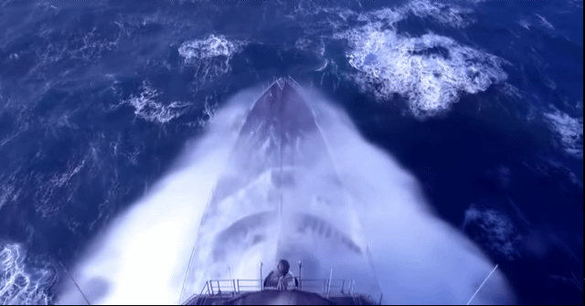
peaceliteracy.org
Notes:
GIF of https://www.youtube.com/watch?v=sDgeYfSZdL4

Slide 9
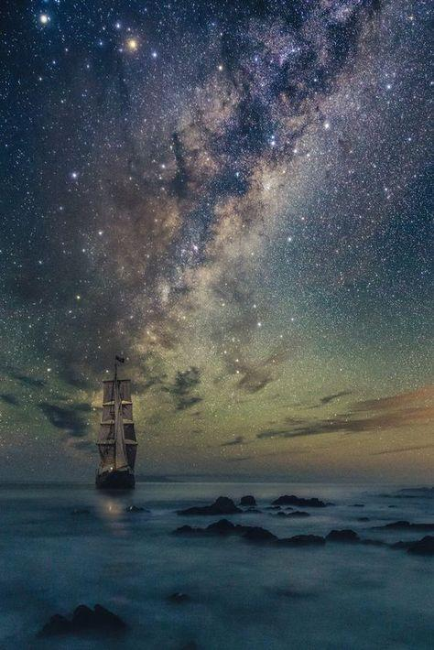
peaceliteracy.org
Our society is changing. We have never before had the kinds of technologies that humanity is now inventing and beginning to use in everyday life.
These new technologies are uncharted waters that no human being before has ever had to navigate. We can and must prepare ourselves to navigate well.
Navigating well allows us to keep moving toward more fulfillment in our lives, greater competency in our humanity, and a more peaceful and just world.
Notes:
Image from Artist Unknown

Slide 10
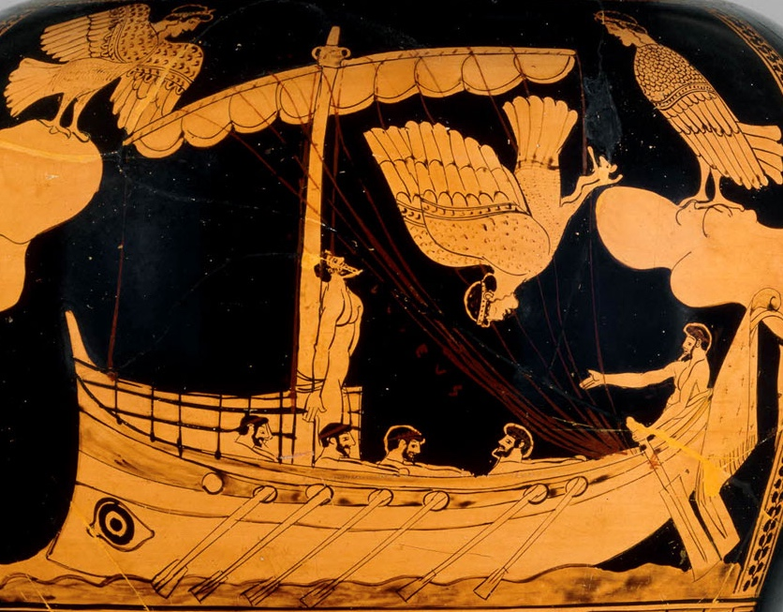
Ancient Greek Ship from the Odyssey circa 11th Century BCE
peaceliteracy.org
Notes:
Image from https://www.britishmuseum.org/research/collection_online/collection_object_details.aspx?objectId=399666&partId=1&searchText=siren+painter&page=1

Slide 11
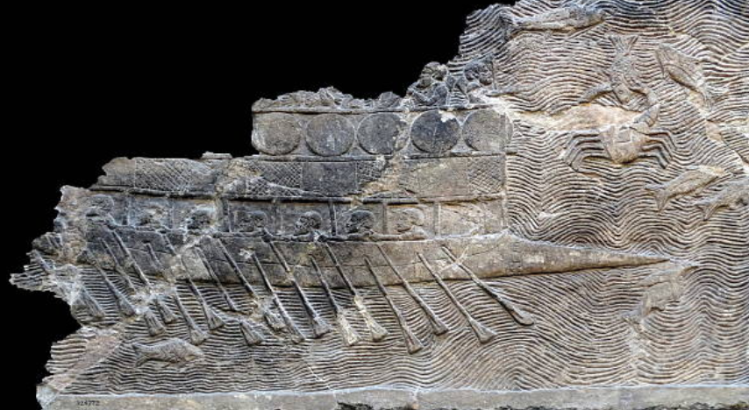
Ancient Phoenician Ship circa 8th Century BCE
peaceliteracy.org
Notes:
Image from https://www.alamyimages.fr/photo-image-bas-relief-assyrien-hysteria-probablement-construit-et-occupe-par-les-pheniciens-employes-par-sancherib-cest-un-bireme-a.

Slide 12
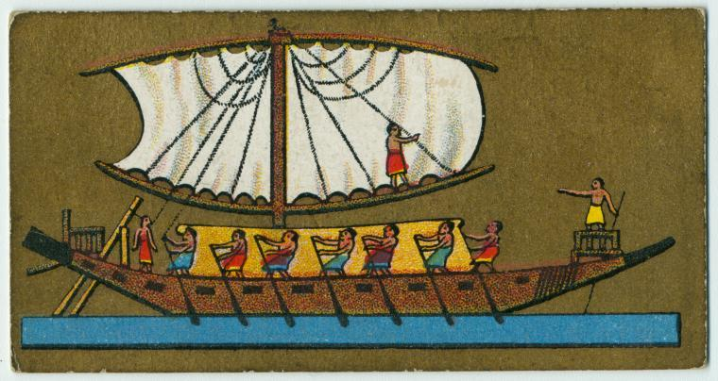
Ancient Egyptian Ship circa 6th Century BCE
peaceliteracy.org
Notes:
Image from https://digitalcollections.nypl.org/items/510d47da-98c1-a3d9-e040-e00a18064a99

Slide 13
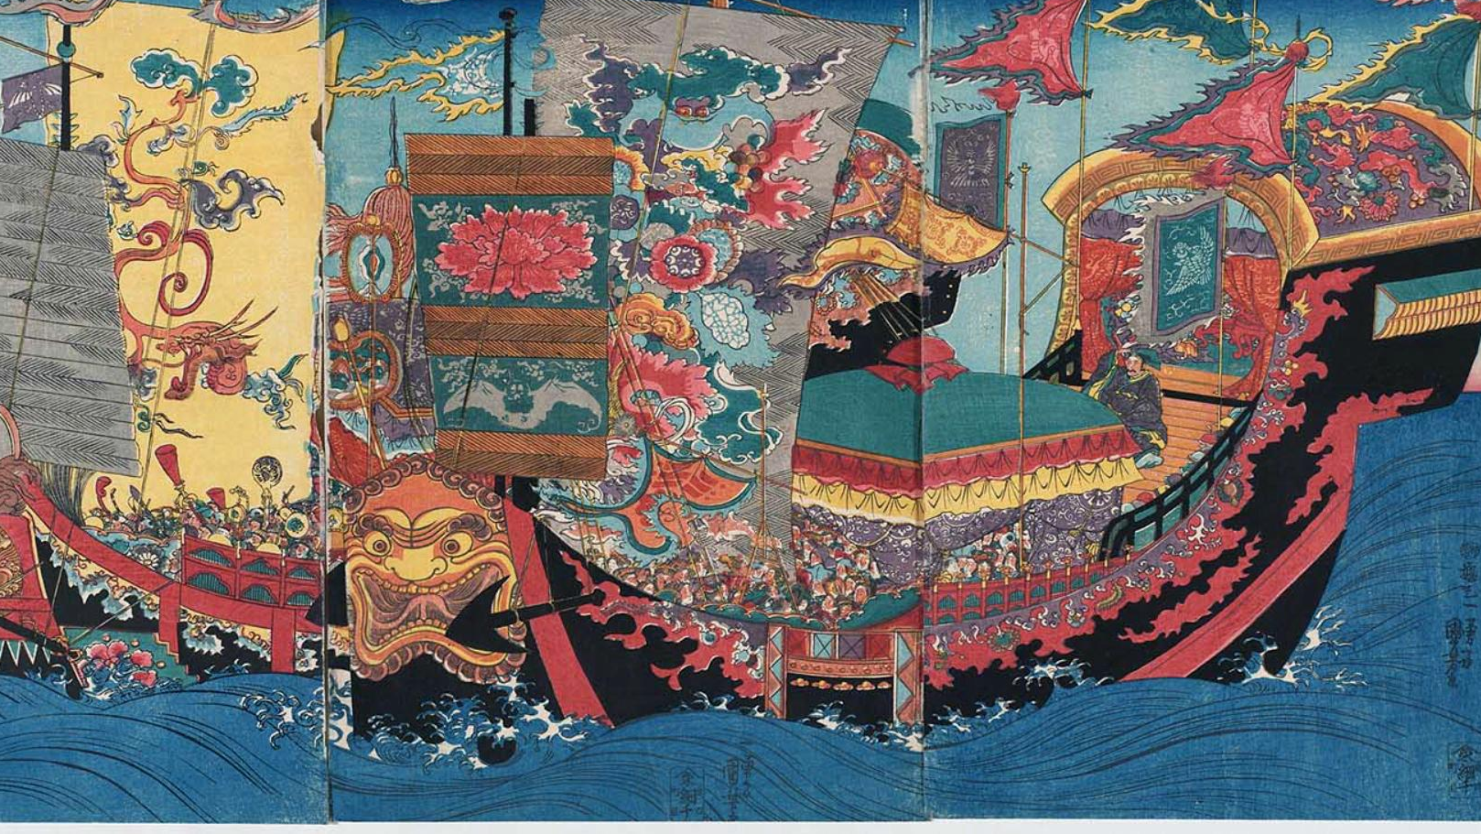
Ancient Ships of first Chinese Emperor Qin Shi Huang circa 3rd Century BCE
peaceliteracy.org
Notes:
Image from https://www.bbc.com/mundo/vert-cul-39635995

Slide 14
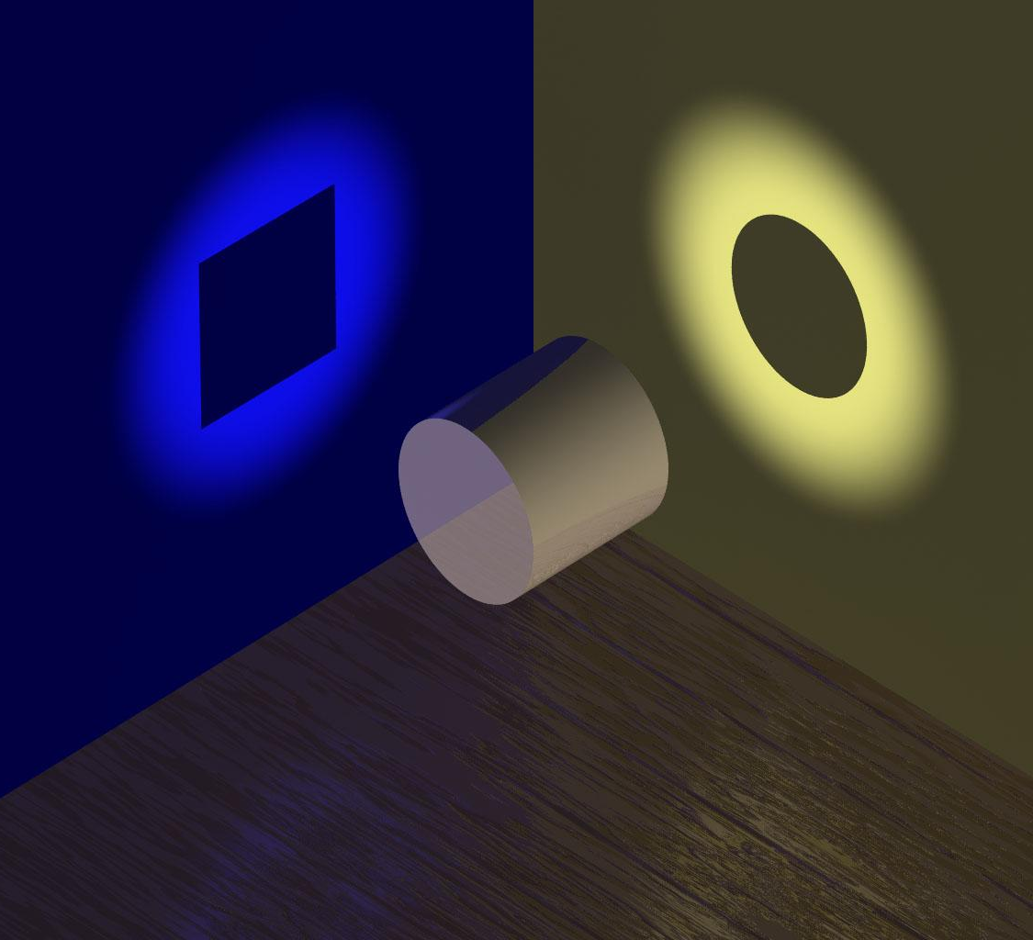
Multiple metaphors show us ideas from different angles.
peaceliteracy.org
Notes:
Image on right from http://www.scientificskeptic.com/tag/truth-claims/

Slide 15
into the steel of adult idealism which will never be lost.” - Albert Schweitzer, Nobel Peace Prize Laureate
peaceliteracy.org
“[We must transform] the soft iron of youthful idealism…
Notes:
Image from http://whatisengineering.com/topic/metallurgical-engineering/

Slide 16
“Steel is an ideal material for bridges. It is an essential part of modern bridges because it is strong, can flex without fracturing, and has a long life, even in the harshest conditions.” -metallurgist Satyendra Kumar Sarna
peaceliteracy.org
Notes:
Image from Artist Unknown

Slide 17
“[Ideals] are your rallying points: to build courage when courage seems to fail; to regain faith when there seems to be little cause for faith; to create hope when hope becomes forlorn . . . these are some of the things they do. They build your basic character… they make you strong enough to know when you are weak, and brave enough to face yourself when you are afraid . . . they teach you to be proud and unbending in honest failure, but humble and gentle in success; not to substitute words for action; not to seek the path of comfort, but to face the stress and spur of difficulty and challenge; to learn to stand up in the storm, but to have compassion on those who fall; to master yourself before you seek to master others; to have a heart that is clean, a goal that is high; to learn to laugh, yet never forget how to weep; to reach into the future, yet never neglect the past; to be serious, yet never take yourself too seriously; to be modest so that you will remember the simplicity of true greatness, the open mind of true wisdom.”
peaceliteracy.org
- General Douglas MacArthur
Notes:
Background image from https://www.ralspace.stfc.ac.uk/SiteAssets/001_CTM_Welcome_ASC2018.pdf

Slide 18
IF YOU DON’T DEVELOP YOUR IDEALS, THEY DON’T JUST STAY NEUTRAL. THEY CAN RUST. THIS RUST CAN TAKE THE FORM OF CYNICISM, DISILLUSIONMENT, AND BITTERNESS.
peaceliteracy.org
Notes:
Background image from https://zientziakaiera.eus/2015/07/25/ezjakintasunaren-kartografia-75/

Slide 19
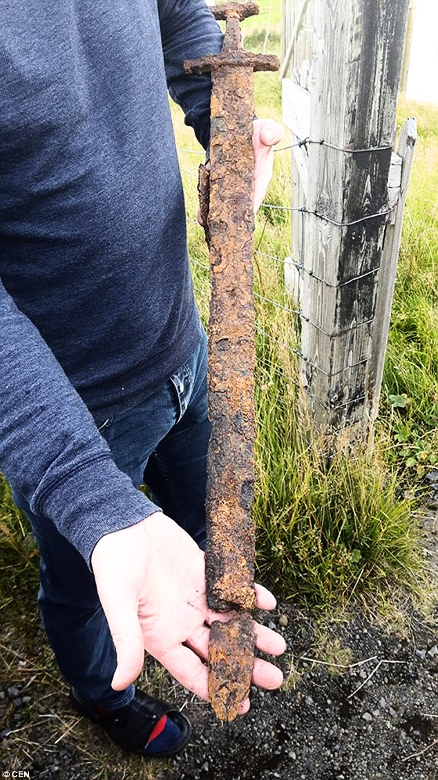
How useful would this sword be?
peaceliteracy.org
Notes:
Image from https://www.dailymail.co.uk/sciencetech/article-3777609/Did-Viking-sword-belong-Icelander-1-000-year-old-weapon-unearthed-geese-hunters.html

Slide 20
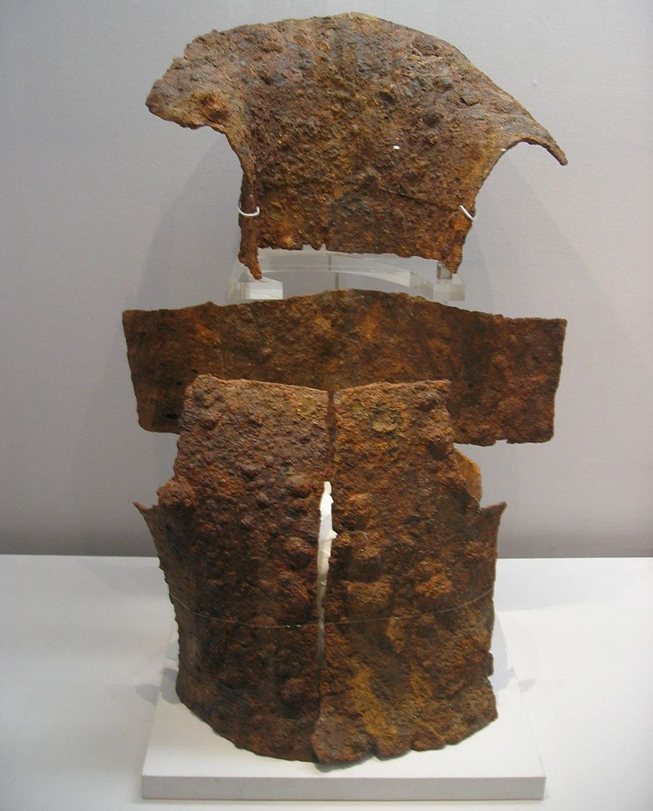
Would you feel safe with this Armor?
peaceliteracy.org
Notes:
Image from https://commons.wikimedia.org/wiki/File:Korea-Silla-Iron.armor-01.jpg

Slide 21
FORGES USE TIME, FIRE, AND THE RIGHT INGREDIENTS TO TRANSFORM SOFT IRON INTO STAINLESS STEEL.
peaceliteracy.org
Notes:
Image from Artist Unknown

Slide 22
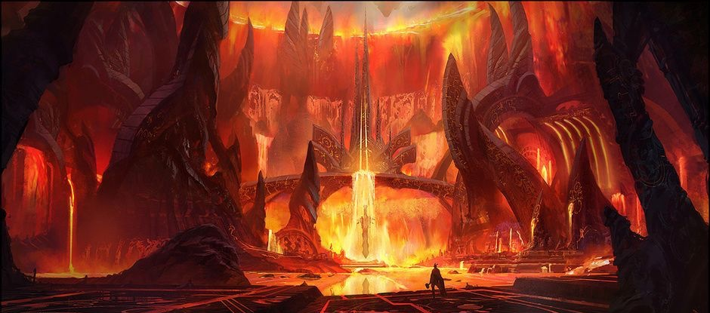
In the forge of life we develop the best of our humanity.
peaceliteracy.org
Notes:
Photo Credit (Concept Art for Thor: God of Thunder video game from Scribble Pad Studios and Sega). https://kotaku.com/the-mighty-thor-faces-his-deadliest-foe-yet-5591803
Part 3 of this unit, The Allegory of Video Games, will further frame video games within an educational context.

Slide 23
Peace Literacy Curriculum©️ The Constellation of Peace You can find Slides To accompany The Next Section Part 2: The Stars of Struggle, Training, Truth, and Strategy at peaceliteracy.org For more info contact Paul K. Chappell at pchappell@napf.org
peaceliteracy.org
Notes:
Image from Artist Unknown

