Slide 1
SLIDES TO ACCOMPANY PEACE LITERACY CURRICULUM©️ THE CONSTELLATION OF PEACE PART2: THE STARS OF STRUGGLE, TRAINING, TRUTH, AND STRATEGY available at peaceliteracy.org Prepared by Paul K. Chappell and Stephanie Clapes
peaceliteracy.org
Notes:
Image from Artist Unknown

Slide 2
THE STARS OF STRUGGLE, TRAINING, TRUTH, AND STRATEGY
peaceliteracy.org
Notes:
Image from Artist Unknown

Slide 3
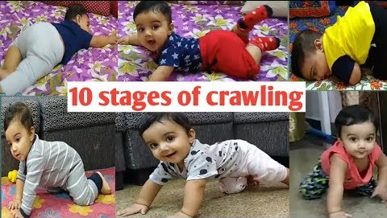
peaceliteracy.org
https://www.youtube.com/watch?v=G4XPKAMldGI

Slide 4
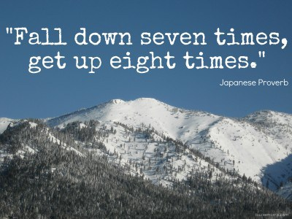
“Realistic peace is not the absence of struggle, but the process of transforming struggle into purpose, meaning, empathy, understanding, [and] justice.” Paul K. Chappell, Soldiers of Peace, pg. 53
peaceliteracy.org
Star of Struggle
Notes:
Background image on left fromhttps://ja.videoblocks.com/video/stars-in-the-sky-looped-animation-beautiful-night-with-twinkling-flares-loopable-space-background---cgi-byzxtfjqmjf0b39e4
Image on right from Artist Unknown

Slide 5
Choosing the harder right over the easier wrong often requires us to journey toward struggle.
peaceliteracy.org
Notes:
Background image on left from https://www.ralspace.stfc.ac.uk/SiteAssets/001_CTM_Welcome_ASC2018.pdf
Image on right from https://www.velocityhub.com/high-performer-tip-22-decision-making-fork-road/

Slide 6
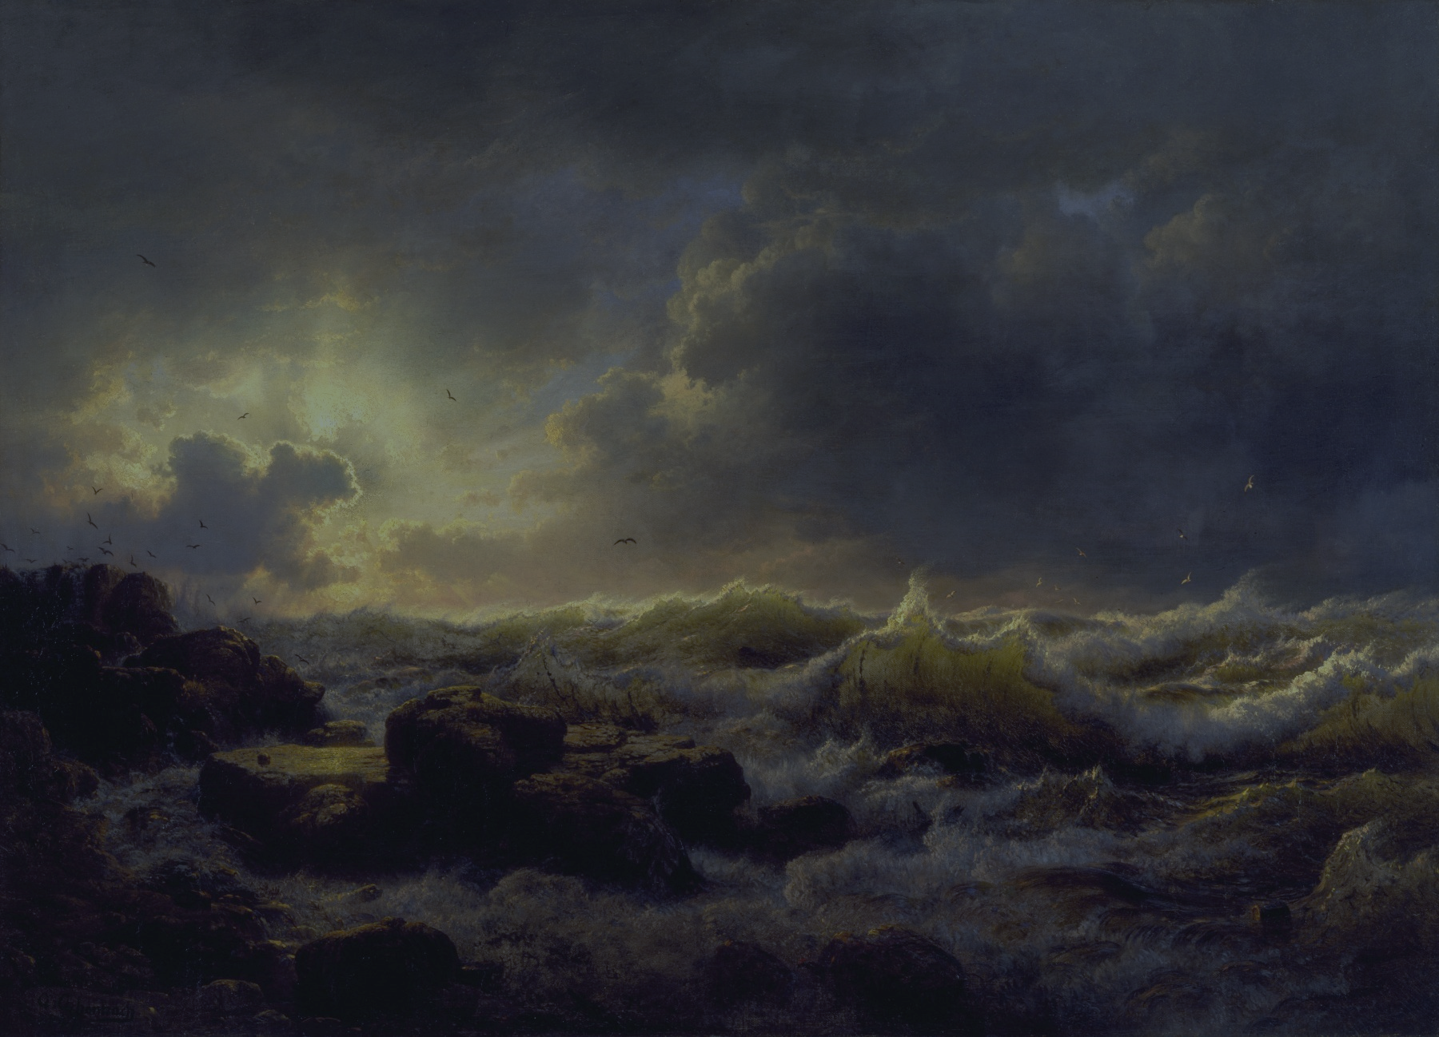
“If there is no struggle, there is no progress . . . [You can’t have] the ocean without the awful roar of its many waters.” Frederick Douglass
peaceliteracy.org
Notes:
Image from Artist Unknown

Slide 7
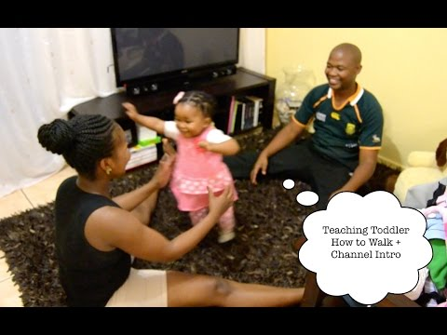
peaceliteracy.org
https://www.youtube.com/watch?v=K1PPaF87E0c

Slide 8
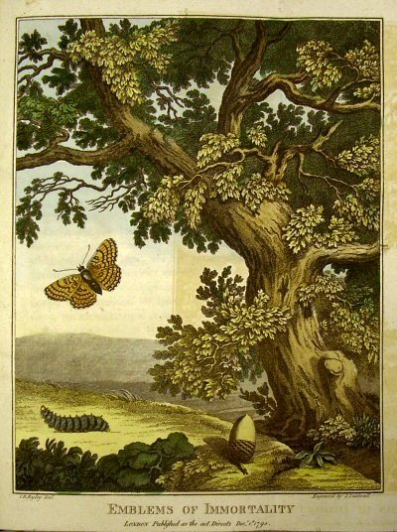
“An oak tree knows how to be an oak tree. It doesn’t need a mentor or role model to guide it. A caterpillar knows how to turn into a butterfly and thrive in the world. It doesn’t have to attend school or be instructed by its parents. But human beings, more than any other creature on the planet, must learn to be what we are. We must learn to be human.” Paul K. Chappell, Soldiers of Peace, pg. 77
peaceliteracy.org
Star of Training
Notes:
Background image on left fromhttps://ja.videoblocks.com/video/stars-in-the-sky-looped-animation-beautiful-night-with-twinkling-flares-loopable-space-background---cgi-byzxtfjqmjf0b39e4
Image on right from Artist Unknown

Slide 9
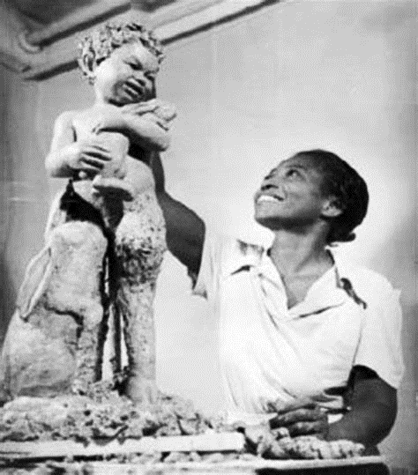
Peace
Literacy
peaceliteracy.org
“There exists no more difficult art than living . . . throughout the whole of life, one must continue to learn to live.” - Seneca, 4 BCE-65 CE, Roman philosopher “The art of living transforms us into both the sculptor and the sculpture. We are the artist and our life is the masterpiece.” -Paul K. Chappell, Peaceful Revolution, pg. 28
Augusta Savage, 1892-1962: sculptor during the Harlem Renaissance
Notes:
Background image on left from https://www.ralspace.stfc.ac.uk/SiteAssets/001_CTM_Welcome_ASC2018.pdf
Image on right from https://artsmidhudson.org/event/augusta-savage-lift-every-voice/

Slide 10
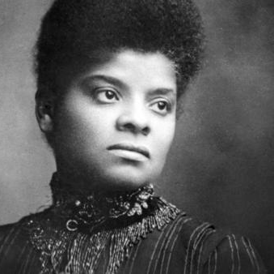
Born a slave in 1862, Ida B. Wells-Barnett went on to become a prominent journalist and activist. “The way to right wrongs is to turn the light of truth upon them.” -Ida B. Wells
peaceliteracy.org
Star of Truth
Notes:
Background image on left fromhttps://ja.videoblocks.com/video/stars-in-the-sky-looped-animation-beautiful-night-with-twinkling-flares-loopable-space-background---cgi-byzxtfjqmjf0b39e4
Image on right from
http://idabwellsmuseum.org/ida-b-wells-barnett/

Slide 11
peaceliteracy.org
https://www.youtube.com/watch?v=XimVrAiFZtM

Slide 12
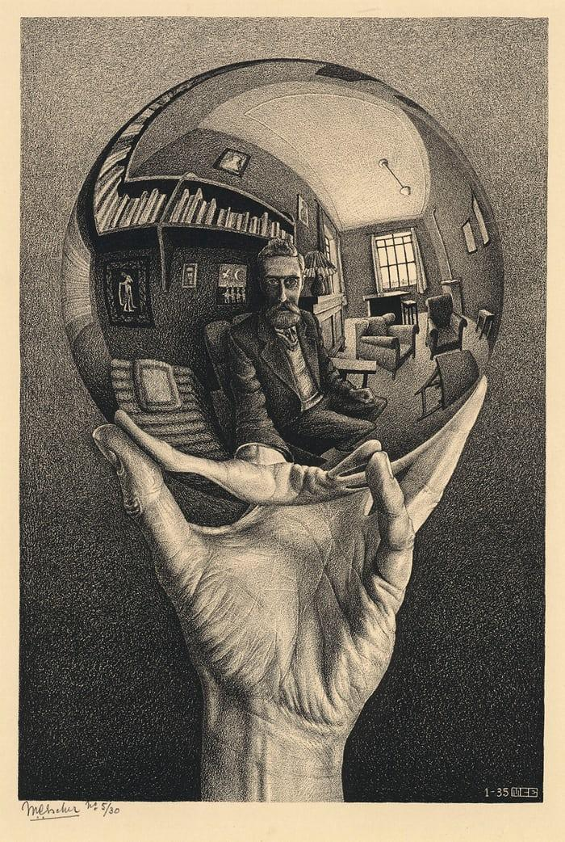
peaceliteracy.org
“I learned that integrity means being honest not only with others, but also with myself. If I am not truthful with myself, then I cannot learn from my mistakes, grow as a human being, and achieve my full potential.”
-Paul K. Chappell, Soldiers of Peace, pg. 167
Notes:
Image by M. C. Escher

Slide 13
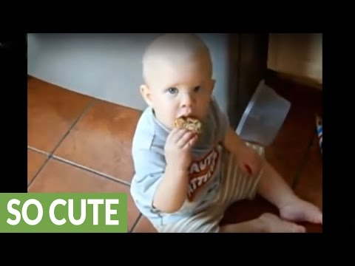
peaceliteracy.org
https://www.youtube.com/watch?v=QwgIKMwMkLQ

Slide 14
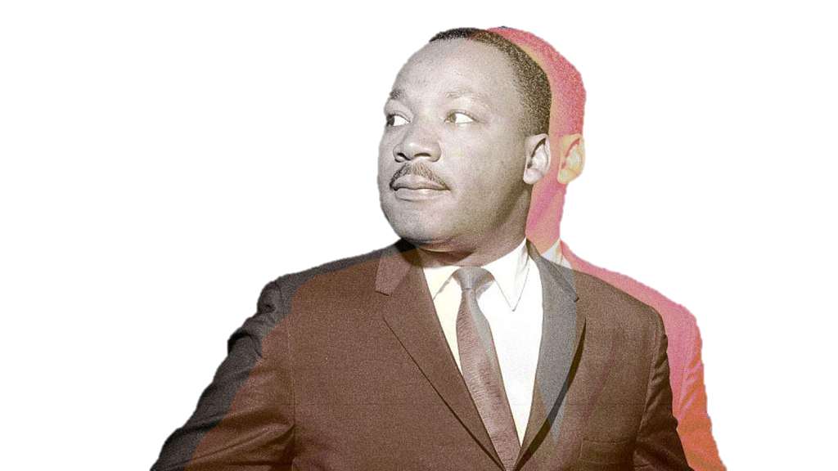
peaceliteracy.org
Nonviolence is a powerful and just weapon which cuts without wounding and ennobles the man who wields it.
It is a sword that heals.”
Dr. Martin Luther King Jr
Star of Strategy
Brute force usually deals with symptoms of problems, whereas strategy enables us to understand and confront root causes of problems. Nonviolence is the highest evolution of strategy, because nonviolence gives us
the greatest ability to understand and confront root causes of problems.
Notes:
Background image on left fromhttps://ja.videoblocks.com/video/stars-in-the-sky-looped-animation-beautiful-night-with-twinkling-flares-loopable-space-background---cgi-byzxtfjqmjf0b39e4
Image on right from https://www.follownews.com/what-the-environmental-justice-movement-owes-martin-luther-king-jr-5cgs0

Slide 15
Peace is like a huge engineering project. The engineering needed for peace is far more complex than the engineering needed for buildings, because human beings are far more complex than buildings.
peaceliteracy.org
Notes:
Image from https://www.shutterstock.com/image-vector/monorail-bridge-across-highway-railroad-overpass-781047871?src=vvhZvKliF5k3CYyjYj1AlA-1-11

Slide 16
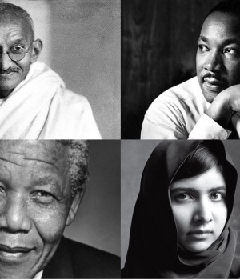
peaceliteracy.org
Peace Heroes
By following the four stars in the Constellation of Peace, they helped engineer a more peaceful and just world.
Reject violence
Raise up justice
Recognize our interconnectedness
Respect and serve the well-being of others
Redefine worth and honor
Notes:
Background image on left fromhttps://ja.videoblocks.com/video/stars-in-the-sky-looped-animation-beautiful-night-with-twinkling-flares-loopable-space-background---cgi-byzxtfjqmjf0b39e4
Image on right from
http://anthillonline.com/4-leadership-lessons-from-4-great-leaders-what-business-owners-can-learn-from-gandhi-mlk-mandela-and-malala/

Slide 17
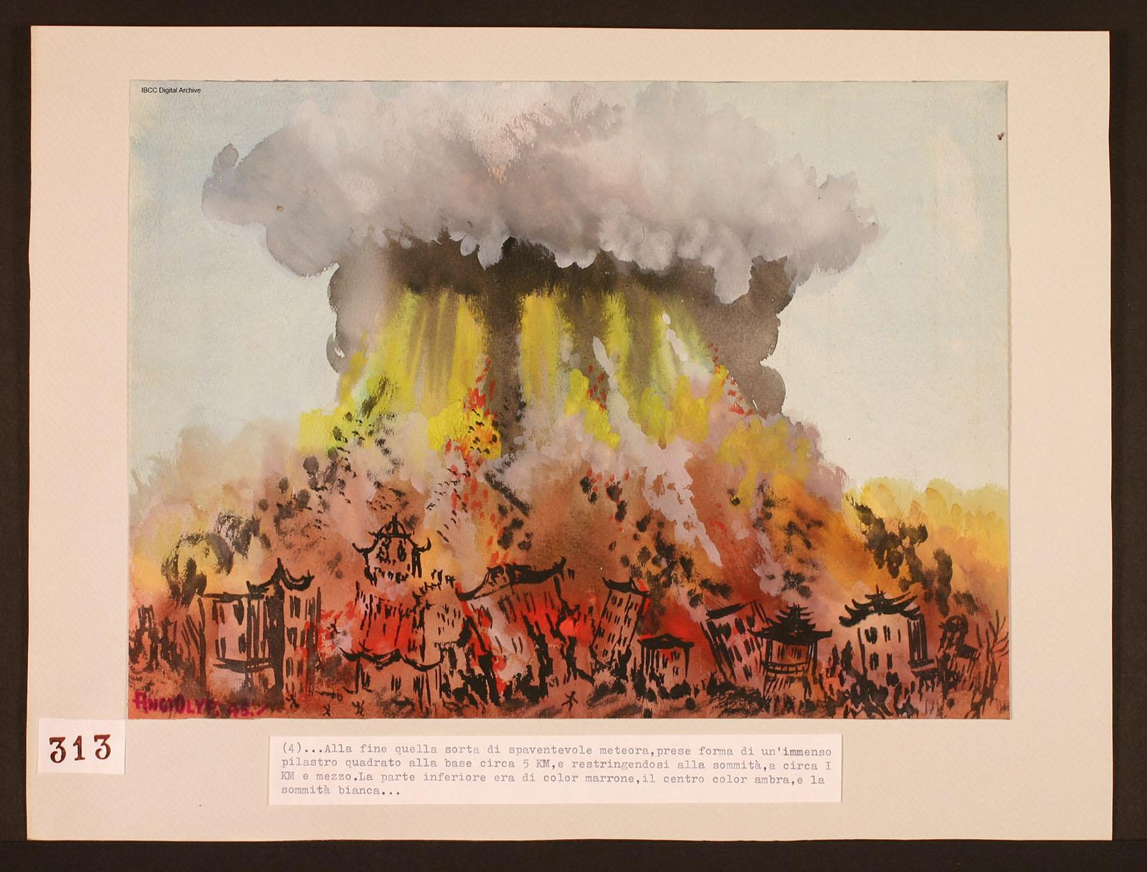
peaceliteracy.org
Waging peace is not physical combat with bombs and bullets, but mental and spiritual combat against hatred, greed, deception, and apathy.
- Paul K. Chappell, The Art of Waging Peace, 2013
Notes:
Image from Artist Unknown

Slide 18
PEACE LITERACY CURRICULUM©️ THE CONSTELLATION OF PEACE YOU CAN FIND SLIDES TO ACCOMPANY THE NEXT SECTION PART 3: THE ALLEGORY OF VIDEO GAMES AT PEACELITERACY.ORG For more info contact Paul K. Chappell at pchappell@napf.org
peaceliteracy.org
Notes:
Image from Artist Unknown

