Slide 1
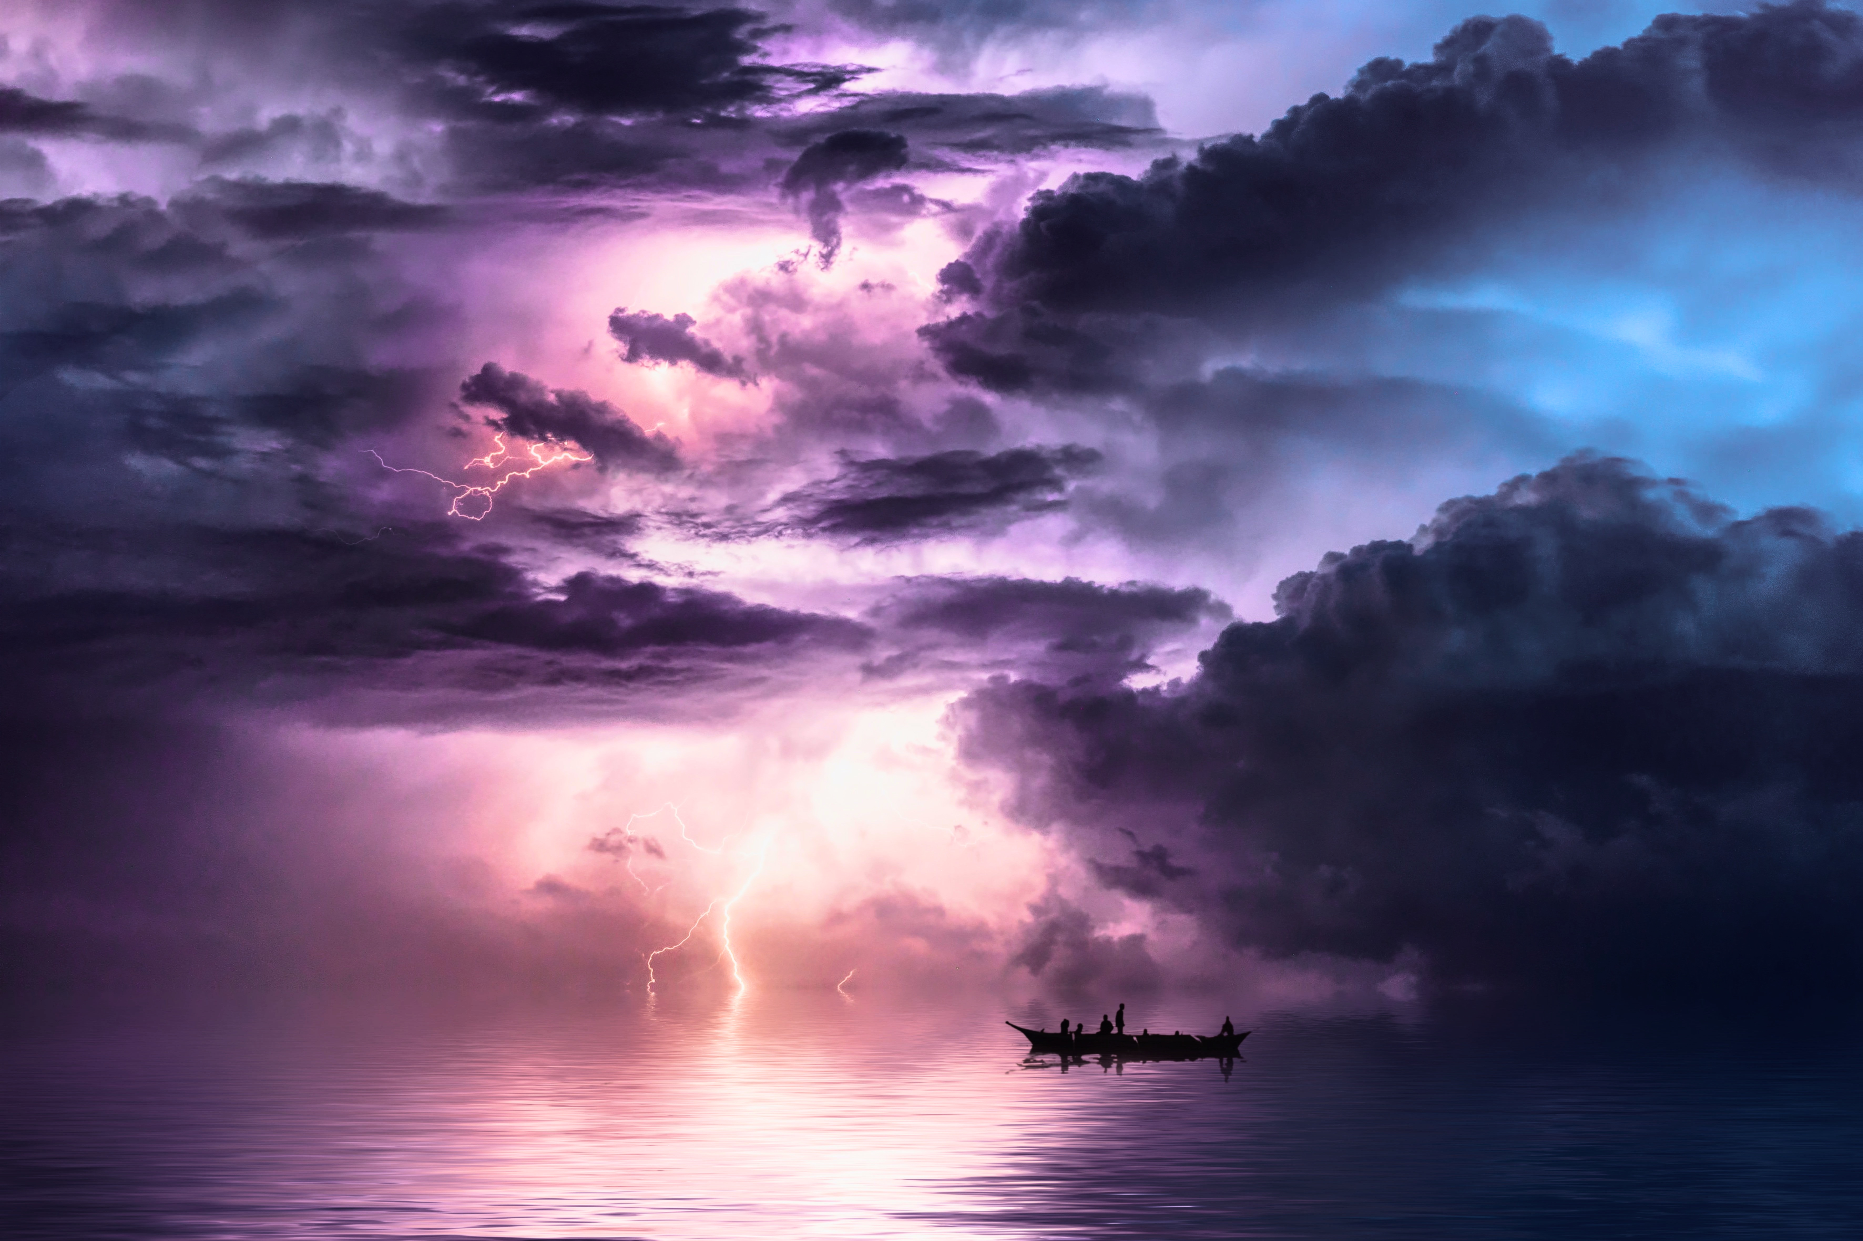
Slides to accompany Peace Literacy Curriculum: Navigating Crisis, Uncertainty, and Technology Part 3: Navigating the Fog of the Digital World Available at peaceliteracy.org Prepared by Paul K. Chappell, Stephanie Clapes, and Donna Cowle
peaceliteracy.org
Notes:
Artist Unknown

Slide 2
peaceliteracy.org
The outer world can affect our inner world. And our inner world can affect the outer world. As we move around in the outer world together, we are affecting each other’s inner worlds.
Notes:
Source for GIF
https://www.ecosia.org/images?q=GIF+spheres+of+light+overlapping#id=3585A884E155EAD7B15A2A80DCE04349F27F7172

Slide 3
peaceliteracy.org
We live not only in the outer world and our inner world, but also in a digital world.
Notes:
Source for GIF
https://www.pinterest.co.kr/pin/466826317618843603/

Slide 4
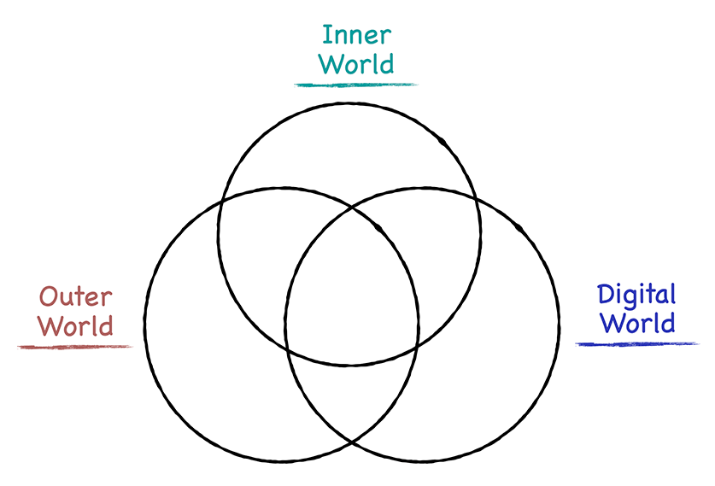
peaceliteracy.org
The digital world overlaps with the outer world and our inner world.
All three of these worlds affect each other.

Slide 5
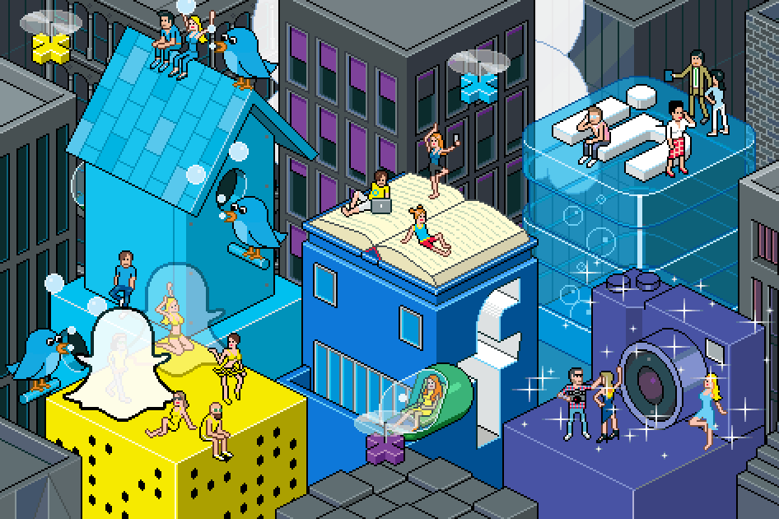
peaceliteracy.org
The digital world overlaps with people’s jobs, their relationships, how they get information, how they spend their time, etc.
Notes:
Source for GIF
https://www.nytimes.com/guides/business/social-media-for-career-and-business

Slide 6
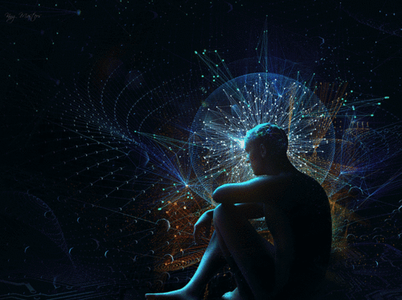
peaceliteracy.org
The storm of COVID-19 has pushed us deeper into the digital world.
This storm has made the digital world even more intertwined with both the outer world and our inner world.
We have entered uncharted waters.
Notes:
Source for GIF
https://www.ecosia.org/images?q=gif+teaching+online#id=E6B9E09BDC903BC1D534899BAA1DD1B3FA4CA300

Slide 7
peaceliteracy.org
Here are just four ways that people spend their time in the digital world:
Notes:
Source for GI: https://gph.is/g/aeBylwqF
https://www.ecosia.org/images?q=gif+teaching+online#id=E6B9E09BDC903BC1D534899BAA1DD1B3FA4CA300

Slide 8
peaceliteracy.org
Notes:
Source for GIF:https://giphy.com/gifs/whiskeyboat-instagram-scrolling-whiskeyboatgoods-cmqnzFK17DO4vKCscd
https://www.ecosia.org/images?q=gif+teaching+online#id=E6B9E09BDC903BC1D534899BAA1DD1B3FA4CA300

Slide 9
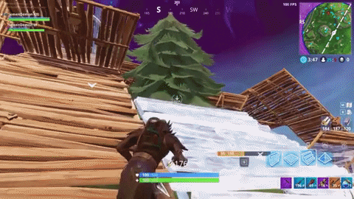
peaceliteracy.org
Notes:
Source for GIF :https://gph.is/g/4oRL2Pm
https://www.ecosia.org/images?q=gif+teaching+online#id=E6B9E09BDC903BC1D534899BAA1DD1B3FA4CA300

Slide 10
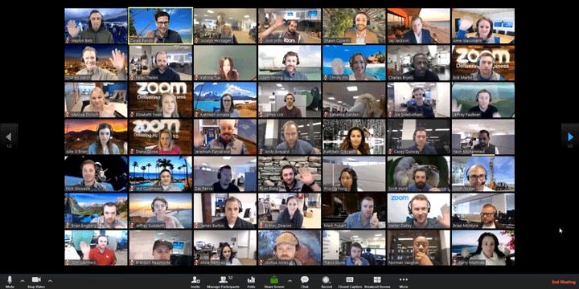
peaceliteracy.org
Notes:
Source for GIF:https://blog.zoom.us/wordpress/2018/01/30/zoom-launches-enhanced-product-suite-to-deliver-frictionless-communications/
https://www.ecosia.org/images?q=gif+teaching+online#id=E6B9E09BDC903BC1D534899BAA1DD1B3FA4CA300

Slide 11
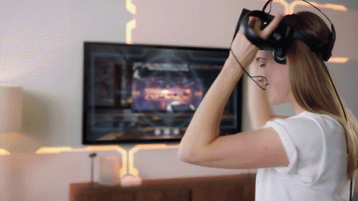
peaceliteracy.org
Notes:
Source for GIF: https://giphy.com/gifs/oculus-vr-virtual-reality-xUA7b7EHL2foKJmShG
https://www.ecosia.org/images?q=gif+teaching+online#id=E6B9E09BDC903BC1D534899BAA1DD1B3FA4CA300

Slide 12
peaceliteracy.org
During the COVID-19 pandemic, which parts of the digital world do you find yourself spending the most time in?
Notes:
Source for GI: https://gph.is/g/aeBylwqF
https://www.ecosia.org/images?q=gif+teaching+online#id=E6B9E09BDC903BC1D534899BAA1DD1B3FA4CA300

Slide 13
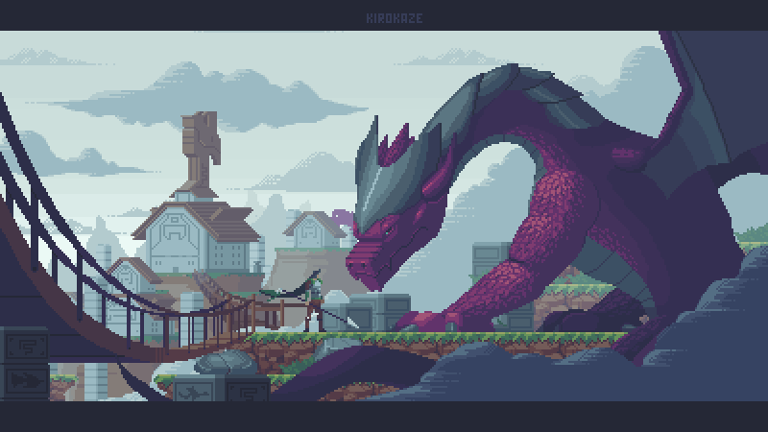
peaceliteracy.org
The digital world can help us in many ways during this storm.
But the digital world has its own challenges that we must navigate.
Notes:
Source for GIF
https://www.ecosia.org/images?q=gif+pixal+dragons#id=AE212A55187E114EEBF054AF93646AAD3FEA8464

Slide 14
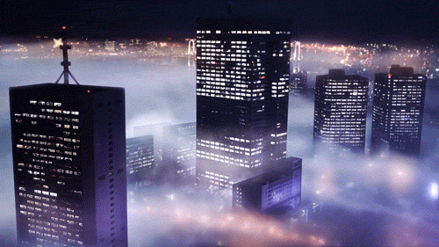
peaceliteracy.org
One of the challenges is that the digital world has a kind of fog that we must learn to see through.
Notes:
Source for GIF Unknown

Slide 15
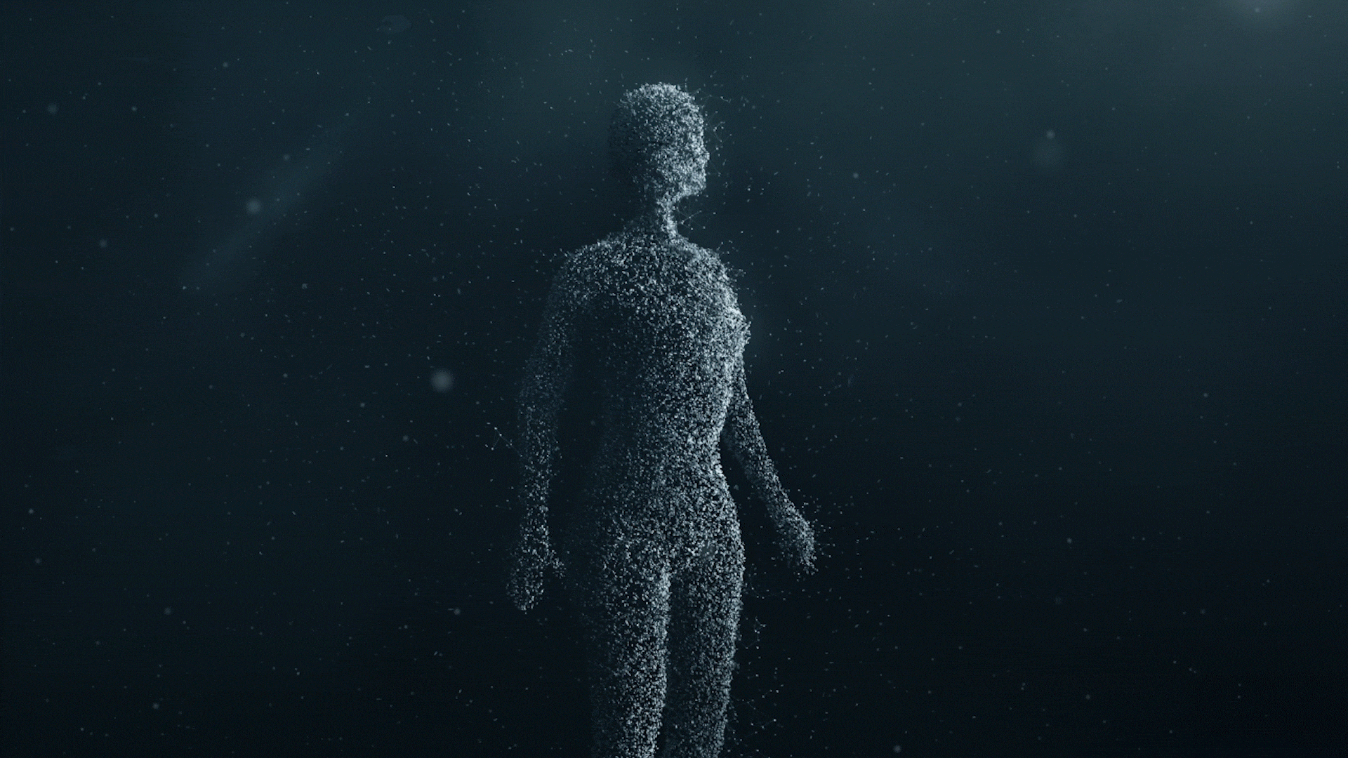
peaceliteracy.org
When we encounter another human being through digital technology,
the technology can act like a layer of fog that varies in intensity.
We call that fog mechanical distance.
Notes:
Source for GIF https://www.volvocars.com/intl/why-volvo/human-innovation/future-of-driving/safety/cars-safe-for-all

Slide 16
peaceliteracy.org
Mechanical distance is a term that the military uses to describe how technology can make it difficult to see each other’s humanity. If we are not careful, this fog can reduce our ability to have empathy for the person on the other side of the machine.
Notes:
Source for GIF https://www.volvocars.com/intl/why-volvo/human-innovation/future-of-driving/safety/cars-safe-for-all

Slide 17
peaceliteracy.org
Mechanical distance is a fog that makes it easier for us to participate in mean-spirited comments on Youtube videos, cyber-bullying on social media, and harassment in online gaming platforms.
Notes:
Source for GIF https://www.volvocars.com/intl/why-volvo/human-innovation/future-of-driving/safety/cars-safe-for-all

Slide 18
peaceliteracy.org
Last class we learned about two essential nutrients that we need for our inner world: empathy and attention.

Slide 19
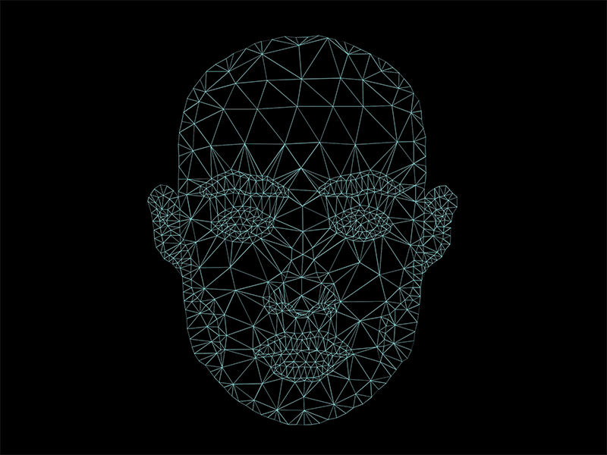
peaceliteracy.org
Why do you think the fog of mechanical distance that we encounter in the digital world can affect our ability to give and receive the important nutrient of empathy?
Notes:
Source for GIF Unknown

Slide 20
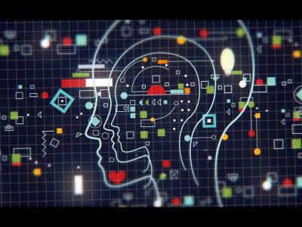
peaceliteracy.org
Why do you think the fog of mechanical distance that we encounter in the digital world can affect our ability to give and receive the important nutrient of attention?
Notes:
Source for GIF
https://www.pinterest.com/pin/123215739792359504/?nic_v1=1atVTo0VYcJn4bozNVeUcXV%2BIBxOaYHaUMF0%2FW9MCCHVSUd4kwJFDiqELkghY47Nfe

Slide 21
peaceliteracy.org
Remember that empathy and attention help build trust.
Notes:
Source for GIF Unknown

Slide 22
peaceliteracy.org
What elements of the digital world can make it difficult to build trust in our relationships?
Notes:
Source for GIF Unknown

Slide 23
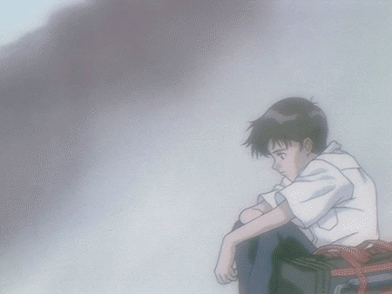
peaceliteracy.org
When we are moving through the digital world, we have to work harder to make sure we are giving these important nutrients to each other, and growing these nutrients within ourselves.
It is important to remember that the fog of mechanical distance can make it even more difficult to see each other’s inner worlds and respond with empathy to the needs we find there.
Notes:
Source for GIF https://weheartit.com/articles/321710221-my-favourite-anime

Slide 24
peaceliteracy.org
Nutrients in our food can help our eyes stay healthy, so we can more clearly perceive the outer world.
When we grow the nutrients of empathy and attention within ourselves, this helps keep our mind healthy.
Having a healthy mind helps us more clearly perceive people's inner worlds.
Notes:
Source for GIF Unknown

Slide 25
peaceliteracy.org
When we use digital technology, the improved vision that empathy and attention gives us is necessary to see through the mechanical distance—the fog—to the person on the other side of the machine: our phones, our game consoles, our laptops, etc.
Notes:
Source for GIF
http://asher.gg/?p=2600

Slide 26
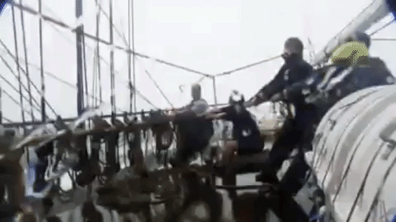
peaceliteracy.org
ALL HANDS ON DECK!
Notes:
Source for GIF
https://www.youtube.com/watch?v=VUSUPL7hprk

Slide 27
peaceliteracy.org
How can you help?
Please consider the following questions,
and post some responses on our Shared Worksite.
When we use digital technology, how can empathy help us see through the fog of mechanical distance?
When we use digital technology, what kinds of healthy habits can we develop to increase our empathy and reduce mechanical distance?
How can giving our full attention to people when we interact with them online help us see through the fog of mechanical distance?

Slide 28
peaceliteracy.org
How can you help?
Please consider the following question,
and post some responses on our Shared Worksite.
Fog can cause us to bump into each other, knock each other down, and even crash our ship.
What kinds of healthy habits can we develop so that as we navigate the digital world, we are not bumping into each other, knocking each other down, and crashing our ship?

Slide 29
peaceliteracy.org
The journey we’ve taken together through these lessons helps us increase our Peace Literacy, which we can use to navigate the digital world in ways that lead toward, rather than away from, a more peaceful and just society.
Notes:
Source for GIF
https://www.nytimes.com/guides/smarterliving/family-technology

Slide 30
That’s all for now! We wish you well on your journey! May you be safe. May you be healthy. May you have courage. May you work for peace. Visit peaceliteracy.org Please share with us any questions or comments you have!
peaceliteracy.org
Notes:
Artist Unknown

