Slide 1


Navigating the Human Condition
in the 21st Century
Lesson 4

Slide 2

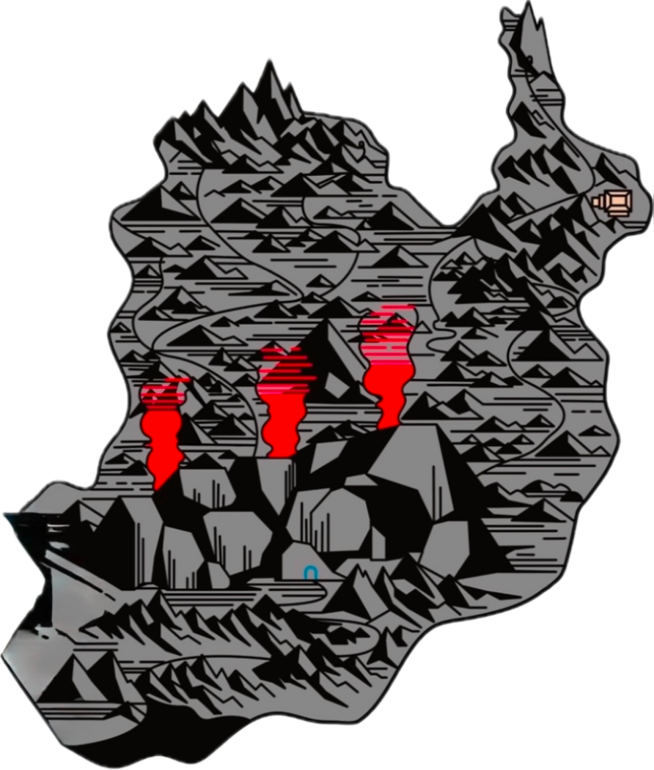



Six Keys Are Needed to Unlock the First Skill
These keys also unlock new ways of understanding people and our society, along with practical ways to help people and improve our society.
1. Expression is a foundational non-physical need that can help us get all of our other needs met.
2. When people don’t have their physical needs met, their need for expression will increase.
4. When people don’t have healthy ways to express themselves, they will tend to use unhealthy ways.
5. Aggression is a form of expression.
6. Aggression is a distress response.
Skill #1:
Using the Eye of Empathy
Aggression is one of the most difficult and dangerous parts of our humanity to deal with.
One of the most valuable life skills we can learn is how to help ourselves when we are struggling with aggression, and how to help others when they are struggling with aggression.
3. People can turn anything into expression, and people can express anything.

Slide 3
Think of empathy as an eye that allows us to see what our physical eyes can’t see.
Our physical eyes typically see only the heat of aggression – someone’s outward behavior.
The Eye of Empathy can see the fires (pain/distress) – the root causes – beneath their outward behavior.
Notes:
Eye of Empathy Closed – On a whiteboard, draw the three heat plumes of aggression rising up from the fires of distress. You or the students can name some of the specific fires of distress beneath the heat plumes. Then draw the eye of empathy being closed.
”What would happen if I am looking only at the heat of aggression, the outward behavior, the surface, and I keep trying to erase those heat plumes?”
Erase the heat plumes, and then draw how they keep coming back because the fire is still underneath.
Eye of Empathy Open – Now draw the eye of empathy opening and looking at the fires of distress.
“When we open our eye of empathy, we are capable of seeing beneath the heat, beneath the outward behavior, beneath the surface. What happens if we then work to reduce the fires beneath aggression that we can now perceive? What will happen to the heat?”
Fully or partially erase the fires to show how this can reduce the heat.
“Empathy is a practical skill for perceiving root causes of problems – the underlying fires – rather than just the symptoms – the surface heat. This allows us to create practical solutions that address root causes rather than just the symptoms.”
”Let’s explore how we can use this skill to help people.”

Slide 4
Exercising the Eye of Empathy
  If you act aggressively and someone can only see your outward behavior, they might think you are just a bad person.
  If they see the fire beneath your aggression, they might instead think that you are having a bad day or a hard time.
  How might an adult treat you if they think you are a bad person?
  How might they treat you if they think you’re having a bad day?
Notes:
Activity – Have students work in pairs to discuss and respond to the questions in their ship’s log.
Note to Teacher: When someone perceives you as having a bad day, this invites them to wonder, “How can I help?” If someone perceives you as just a bad person, then it can seem like there’s nothing they can do to help you, that you are not worth an investment of their time, that helping you would be futile because you are just inherently bad.

Slide 5
  For the following questions, imagine that you are an adult interacting with an adolescent:
  How does seeing the fire beneath someone’s aggression improve your ability to help this person? Why does this improve your ability to help this person?
  What could you say to someone if you realize they are dealing with a fire, but you don’t know exactly what fire they are dealing with?
  Why might someone not want you to know what fire they are dealing with? How can you respond in this situation?
  What could you say if someone is in distress, but they don’t know what fire they are dealing with?
  You can respond with both verbal and non-verbal expression. What are different forms of non-verbal expression that you can use in these scenarios?
  Listening can be a form of non-verbal expression. When someone is listening to you, what can they be expressing?
  7. Kindness is a form of expression that can help to alleviate pain in a variety of ways. In what ways can
  kindness help to alleviate pain? Do you have a story about how simple acts of kindness (words and/or actions)
  can provide comfort without having to talk about the fires?
Note: If someone is in distress and you say “You seem afraid” or “You seem humiliated,” you can come across as intrusive, judgmental, and looking down on them. Instead, expressing yourself through kindness or asking a question such as “Are you okay?” or “How can I help you?” or “What’s wrong?” is more like opening a door and letting someone choose to enter into a conversation.
Notes:
Activity – Have pairs of students discuss and respond to two of the following questions in their ship’s log. Help students choose questions so that all of the questions are answered by at least one pair of students.

Slide 6
    We can use the Eye of Empathy to see and help others
    What kinds of fires might adults be struggling with?
    In what ways can adolescents add to these fires?
    We can use the Eye of Empathy to see and help ourselves
    When we see that we are dealing with a fire such as frustration, we can express this fire by giving it a voice, such as saying “I’m feeling frustrated.”
    Or we can express this fire through the heat of aggression by throwing an object across the room.
    Both actions can be expressions of frustration.
    How can throwing something across the room negatively affect:
      The person who threw the object?
      Other people who might be in the room?
Notes:
Reflection Questions – Have pairs of students discuss and respond to two of the questions in their ship’s logs
Take time to regroup and allow students to share responses to the questions.
“Just as heat from a fire can overwhelm us and distort our perception, the heat of our own aggression can overwhelm us and distort our perception, increasing the likelihood that we will say and do things that we later regret.”
Note to Teacher: Some students might not realize that they can use their words to express frustration in a constructive way. When we use our words, we can help others help us. If nobody is willing to listen to us when we use our words, then we are more likely to throw something (this ties back to the King quote about rioting being the language of the unheard).

Slide 7
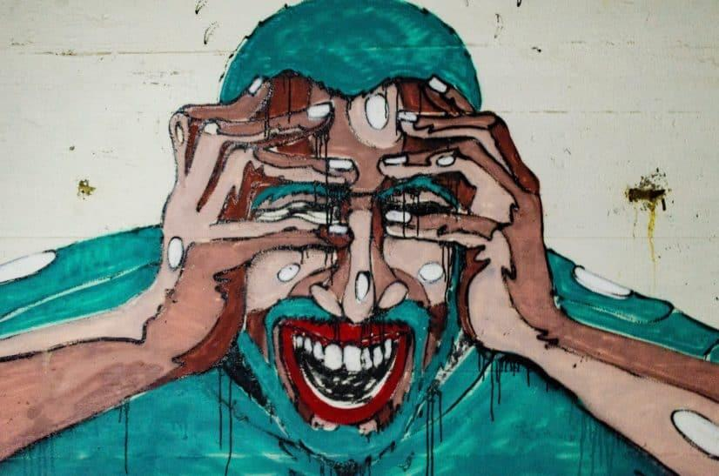
Why did I do that?!
Notes:
“Later, when we are calmer, we may even ask ourselves, ‘Why did I do that?!’”
“Learning to see the fires beneath aggression can help us deal with root causes and express these fires in other ways. This helps us not get stuck in the cycle of aggression and helps us avoid the consequences of impulsive, uncontrolled aggression.”

Slide 8
Aggression is a form of expression.
Fires of Distress
As this diagram shows, aggressive expression is caused by the fires of distress.
Large Toolbox
But distress does not have to lead to aggression; we can express ourselves without using aggression.
Small Toolbox
Non-Aggressive Expression
Aggression is a small toolbox. Non-aggressive expression is a much larger toolbox.
Aggressive Expression
When we learn skills for non-aggressive expression, we gain access to a much larger range of options.
Notes:
Note to Teacher: The diagram helps remind students that there are many ways to express distress. Non-aggressive expression is a large toolbox with many tools in it. Aggression is a small toolbox with limited tools.

Slide 9
Criteria | Level I Competency | Level II Competency | Level III Competency | Level IV Competency
You are developing self-awareness of distress when acting aggressively or thinking aggressive thoughts. | You can recognize your feelings of distress underlying aggressive thoughts and actions after conflict/incident has occurred. | You can recognize your feelings of distress during the conflict/incident and you are able to attempt to stop or minimize the behavior during the conflict/ incident. | You can recognize feelings of distress before aggression or aggressive thoughts. You can redirect these thoughts or actions and keep them from occurring. | You can recognize that this skill is context dependent – we can be skilled at this awareness in some contexts but not others. As you practice getting more consistent, you can exercise self-compassion if your skill level fluctuates.
  Even if you can only respond with a Level 1 competency, this can still make a big difference in your life and the lives of others.
  Why do you think that is?
  Our skill at Level 1 can vary in depth, such as when we make deeper connections between fires and our past experiences.
Notes:
“You can think of empathy as an eye that helps you see, but you can also think of empathy as a skill you can develop.”
Read through each level of the rubric.
Give an example (this could be a personal story or a scenario you make up) to illustrate each level of the rubric. Or have one or two students think of an example (this could be a personal story or a scenario they make up) to illustrate each level.
Regarding Level 4, tell students, “In terms of this skill being context dependent and able to fluctuate, when you are with your friends you might be able to use this skill very well at diffusing situations, but when you are with your sibling you might have more difficulty using this skill. You might be able to use this skill well on a particular day, but the next day you are tired and stressed and not able to use the skill as well.”
Click to reveal the note and question below the rubric.

Slide 10

The Island of Aggression
9. Calm is powerful because it increases our discernment and how well we can use our skills.
Three More Keys Are Needed to Journey
to the Next Island
Athena (skill, strategy, calm, clear thinking) is more powerful than Ares (rage).
Deimos and Phobos represent the fear, panic, or anxiety caused by being the target of human aggression.
Aggression is a form of expression.
Aggression is a distress response.
Skill #1:
Using the Eye of Empathy

Slide 11
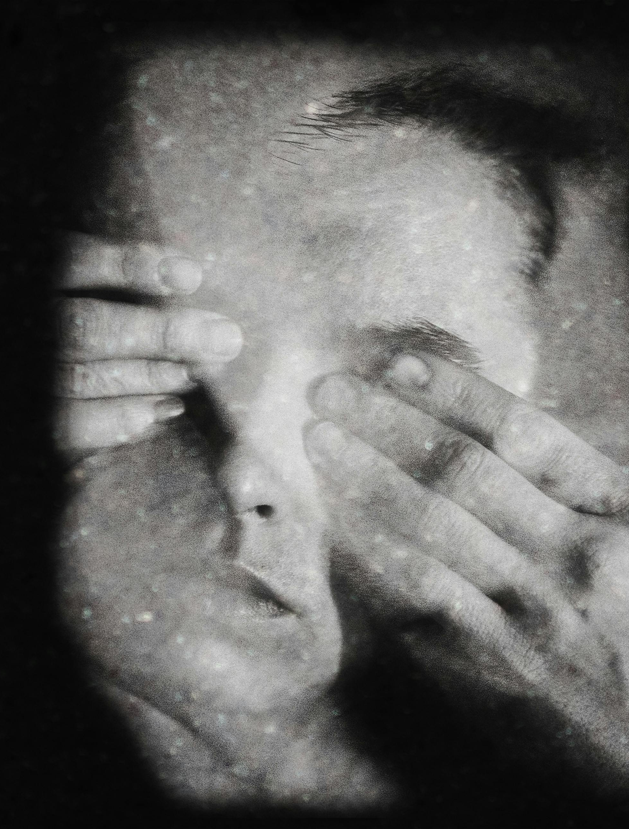
Are there people who want you to keep your Eye of Empathy closed?
Why might they want you to keep your Eye of Empathy closed?
What are some things people can do when they are trying to get you to close your Eye of Empathy?
Why might someone want to close their own Eye of Empathy?
Notes:
Image from: https://www.pexels.com/photo/person-covering-eyes-with-hands-against-dark-background-5917762/

Slide 12

ELA Reflection Activity:
  The Iliad was written nearly 3,000 years ago, and one of its themes is the harmful consequences of unchecked rage.
  Think of a character in a book you have read who wrestles with their own aggression.
    In your ship’s log:
    State the book and character.
    Reflect on and describe some of the fires that cause their aggression.
    Explain the consequences of their aggression.
  Or choose a particular conflict you have studied from history.
    In your ship’s log:
    Briefly describe the historical conflict.
    What were the main fires that caused the conflict?
Notes:
Image Source: Cover of Stephen Mitchell’s 2011 translation of Homer’s The Iliad.

