Slide 1
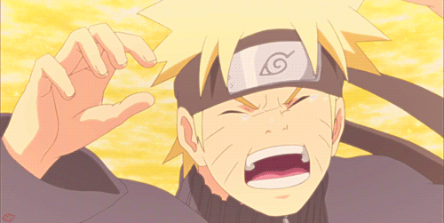
Peace Literacy
peaceliteracy.org
AGGRESSION, DISTRESS AND EMPATHY
Notes:
https://images.app.goo.gl/3RtwWut47VqnX

Slide 2
peaceliteracy.org
Peace Literacy: Day 2
In our last session we talked about how aggression, even passive aggression, is caused by the fires of distress.
When you find yourself or others behaving with passive aggression, can you tell what kind of distress is causing that fire?
Here’s some examples from Jimmy Kimmel on passive aggressive texting: https://www.youtube.com/watch?v=07TinrpKG6o
Notes:
Source for GIF
http://jbkengineering.co.za/

Slide 3
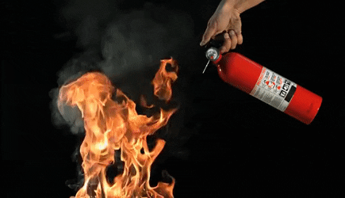
peaceliteracy.org
Peace Literacy: Day 2
We have already discussed how empathy can help us to recognize and calm the fires of distress beneath our own and other people’s aggression.
Notes:
Source for GIF
http://jbkengineering.co.za/

Slide 4
Peace Literacy: Cultivating Calm
Distressing emotions or fires can lead to the heat of aggression.
But they don’t have to.
We can calm these fires before we become aggressive.
What are some ways to respond to our pain and emotions, to calm the fires?
Draw, write, or sketch a way to calm the fires of painful emotion.
What makes you feel better?
Notes:
Source for GIF

Slide 5
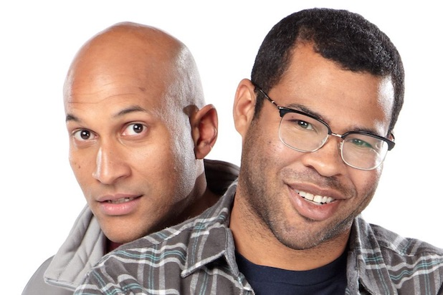
Peace Literacy: Cultivating Calm in Others
peaceliteracy.org
Let’s think back to the Key and Peele sketch.
Michael Kegan Key’s character used a number of Peace Literacy Skills.
What were some of the things he did to calm Jordan Peele’s character (or at least to keep Jordan Peele’s character from escalating the violence)?
https://www.youtube.com/watch?v=CUvFeyGxaaU
Notes:
He stayed calm!
Staying calm is the first step to keeping other people calm.
Telling people “Calm down” almost never works!
Ask students: Why does telling people to calm down rarely work? Allow for responses.
Answer: When people are upset, they usually feel that they have a right to be upset, that they are justified in being upset.
Telling people to calm down can feel dismissive of their distress and in some cases even demeaning.
Ask students: What else did Michael Keegan Key’s character do well? Allow for responses.

Slide 6
Cultivating Calm in Others
peaceliteracy.org
There are three main steps for cultivating calm in others:
Be calm ourselves. (Aggression and panic can be contagious, but calm can be contagious too.)
Listen with empathy and be respectful.
Show care and concern.

Slide 7
Cultivating Calm in Others
peaceliteracy.org
Even though Michael Keegan Key’s character stayed calm, he was not passively “turning the other cheek.”
He was actively practicing peace skills.
These three skills for calming others are not a guarantee; they might not always completely calm the situation.
However, they will:
Give you a higher probability of success.
Be far less likely to escalate the conflict.
Decrease the likelihood of creating bad blood.

Slide 8
Cultivating Calm in Ourselves
peaceliteracy.org
There are four main steps for cultivating calm in ourselves:
Maintain empathy
Keep things in perspective
Give people the benefit of the doubt
Do not personalize the conflict

Slide 9
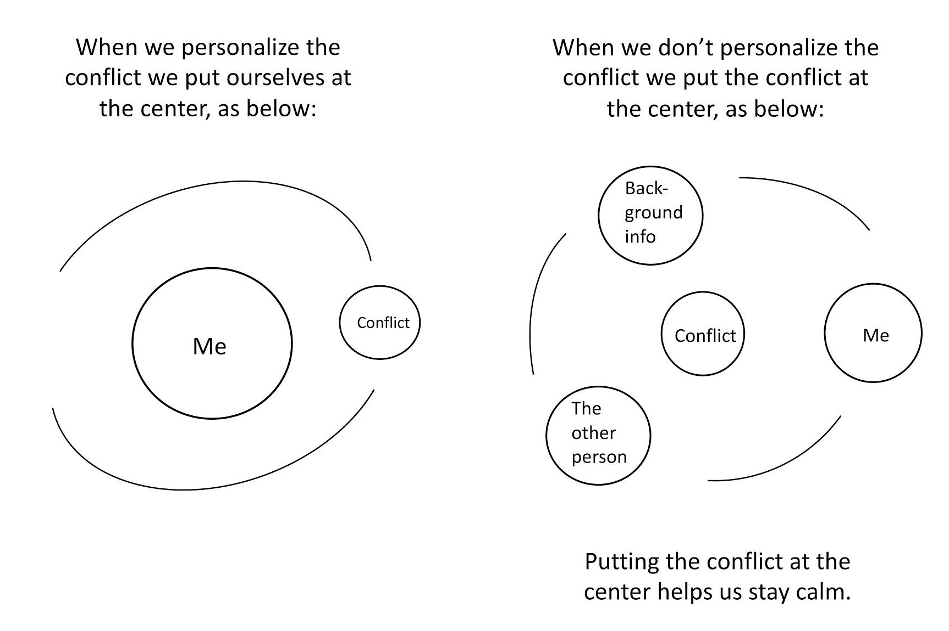
Cultivating Calm in Ourselves: Do not personalize the conflict
peaceliteracy.org

Slide 10
Why Should We Be Calm? They Should be Punished!!!!!
peaceliteracy.org
Staying calm does not mean you do not hold others accountable for their aggression.
Staying calm is the best way to hold them accountable fairly.
(Just as you hope others treat you fairly when you have behaved aggressively)
Notes:
These four skills for calming ourselves down are psychological techniques and are primarily meant to help us remain calm in the midst of conflicts with other humans.
There are also physical techniques, such as “tactical breathing” (next slide) that can help us remain calm in conflicts with humans, or in emergency situations of any kind.

Slide 11
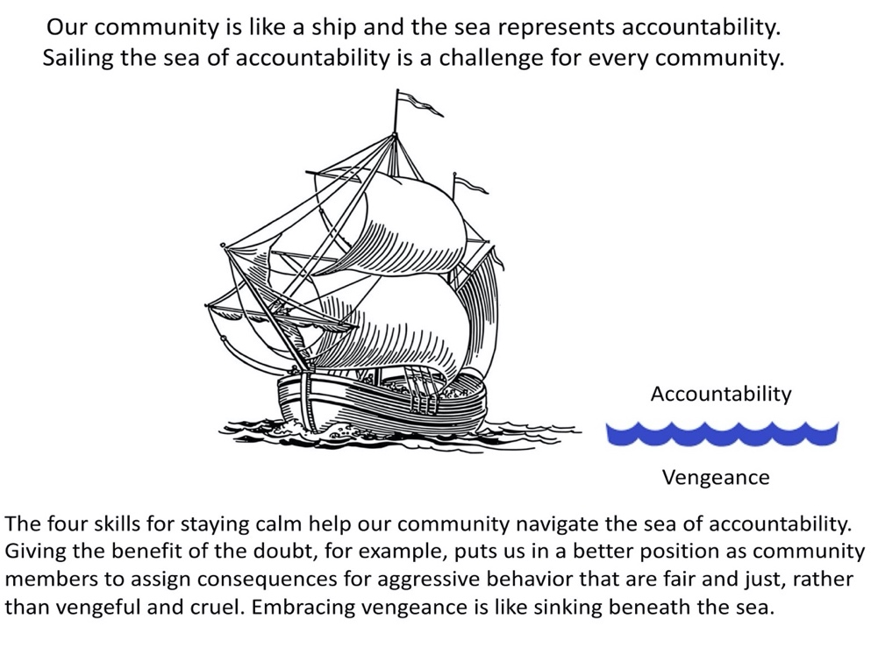
Why Should We Be Calm? They Should be Punished!!!!!
peaceliteracy.org
Notes:
These four skills for calming ourselves down are psychological techniques and are primarily meant to help us remain calm in the midst of conflicts with other humans.
There are also physical techniques, such as “tactical breathing” (next slide) that can help us remain calm in conflicts with humans, or in emergency situations of any kind.

Slide 12
Cultivating Calm in Ourselves:
peaceliteracy.org
Tactical Breathing Exercise to Help Remain Calm in the Midst of Struggle
One of the most common breathing techniques for calming yourself down is Four Count Breathing, also referred to as Tactical or Combat Breathing. Four Count breathing requires you to consciously regulate the amount of airflow your body is receiving over four second intervals. While it can be a difficult technique to master under extreme stress, the principle of the breathing is simple.
1. Slowly inhale a deep breath over 4 seconds.
2. Hold the breath in for 4 seconds.
3. Slowly exhale the breath out over 4 seconds.
4. Hold the empty breath for 4 seconds.
5. Repeat until your breathing is under control.
Notes:
Soldiers need to learn to be calm in the midst of very difficult and even life threatening struggles.
Many soldiers use Tactical Breathing, which can also be called Combat Breathing or Four Count Breathing to help them stay calm under fire.
It is similar to breathing techniques in the yogic tradition that are thousands of years old.
Have students read along with you from p. 4 of their worksheets the following passage from Lt. Col. Dave Grossman’s book On Combat:

