Slide 1
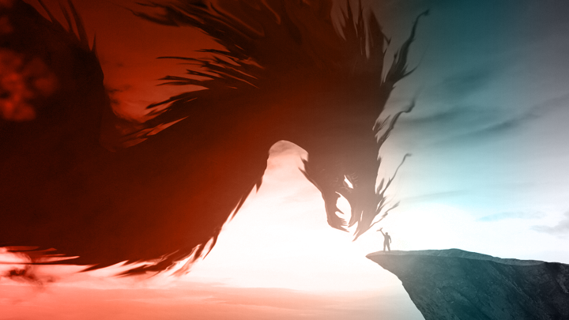
Visiting the Peace Literacy Metaverse
peaceliteracy.org

Slide 2
All of the worlds in the Peace Literacy Metaverse are allegories.
An allegory is a metaphor in story form.
All of the worlds in the Peace Literacy Metaverse interconnect to create a larger epic story.

Slide 3
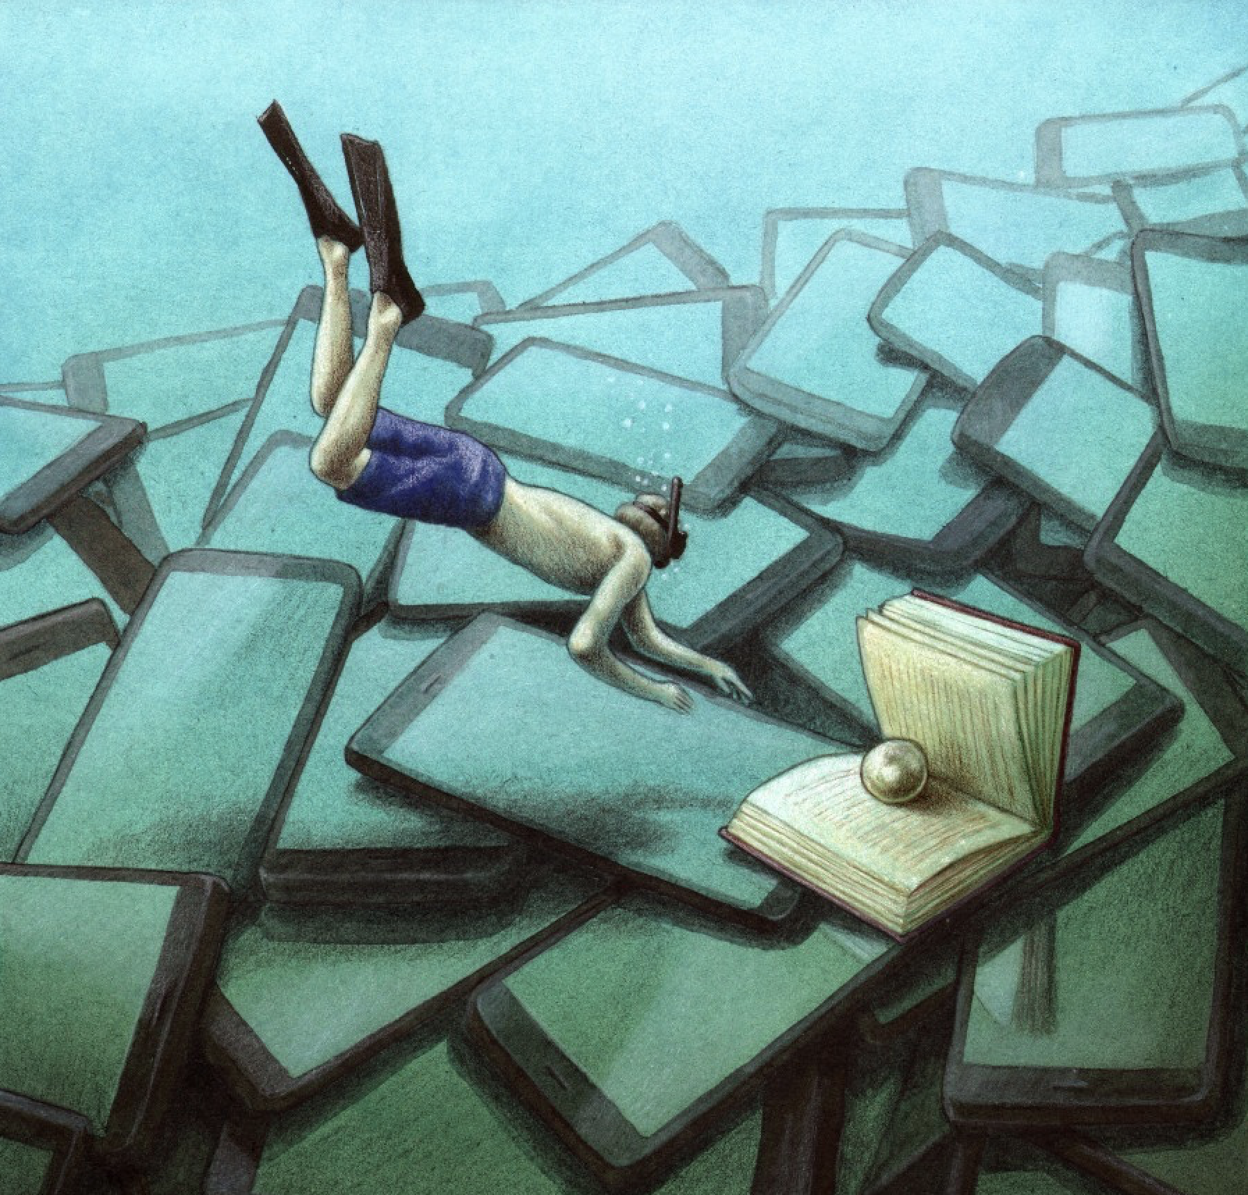
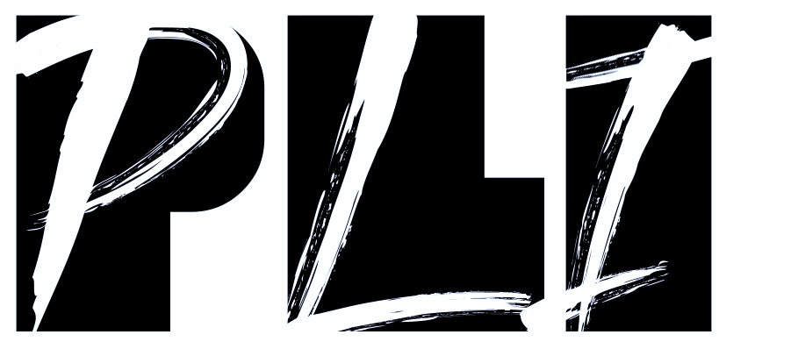
What elements do you notice in this image?
What metaphorical story is being told here?

Slide 4
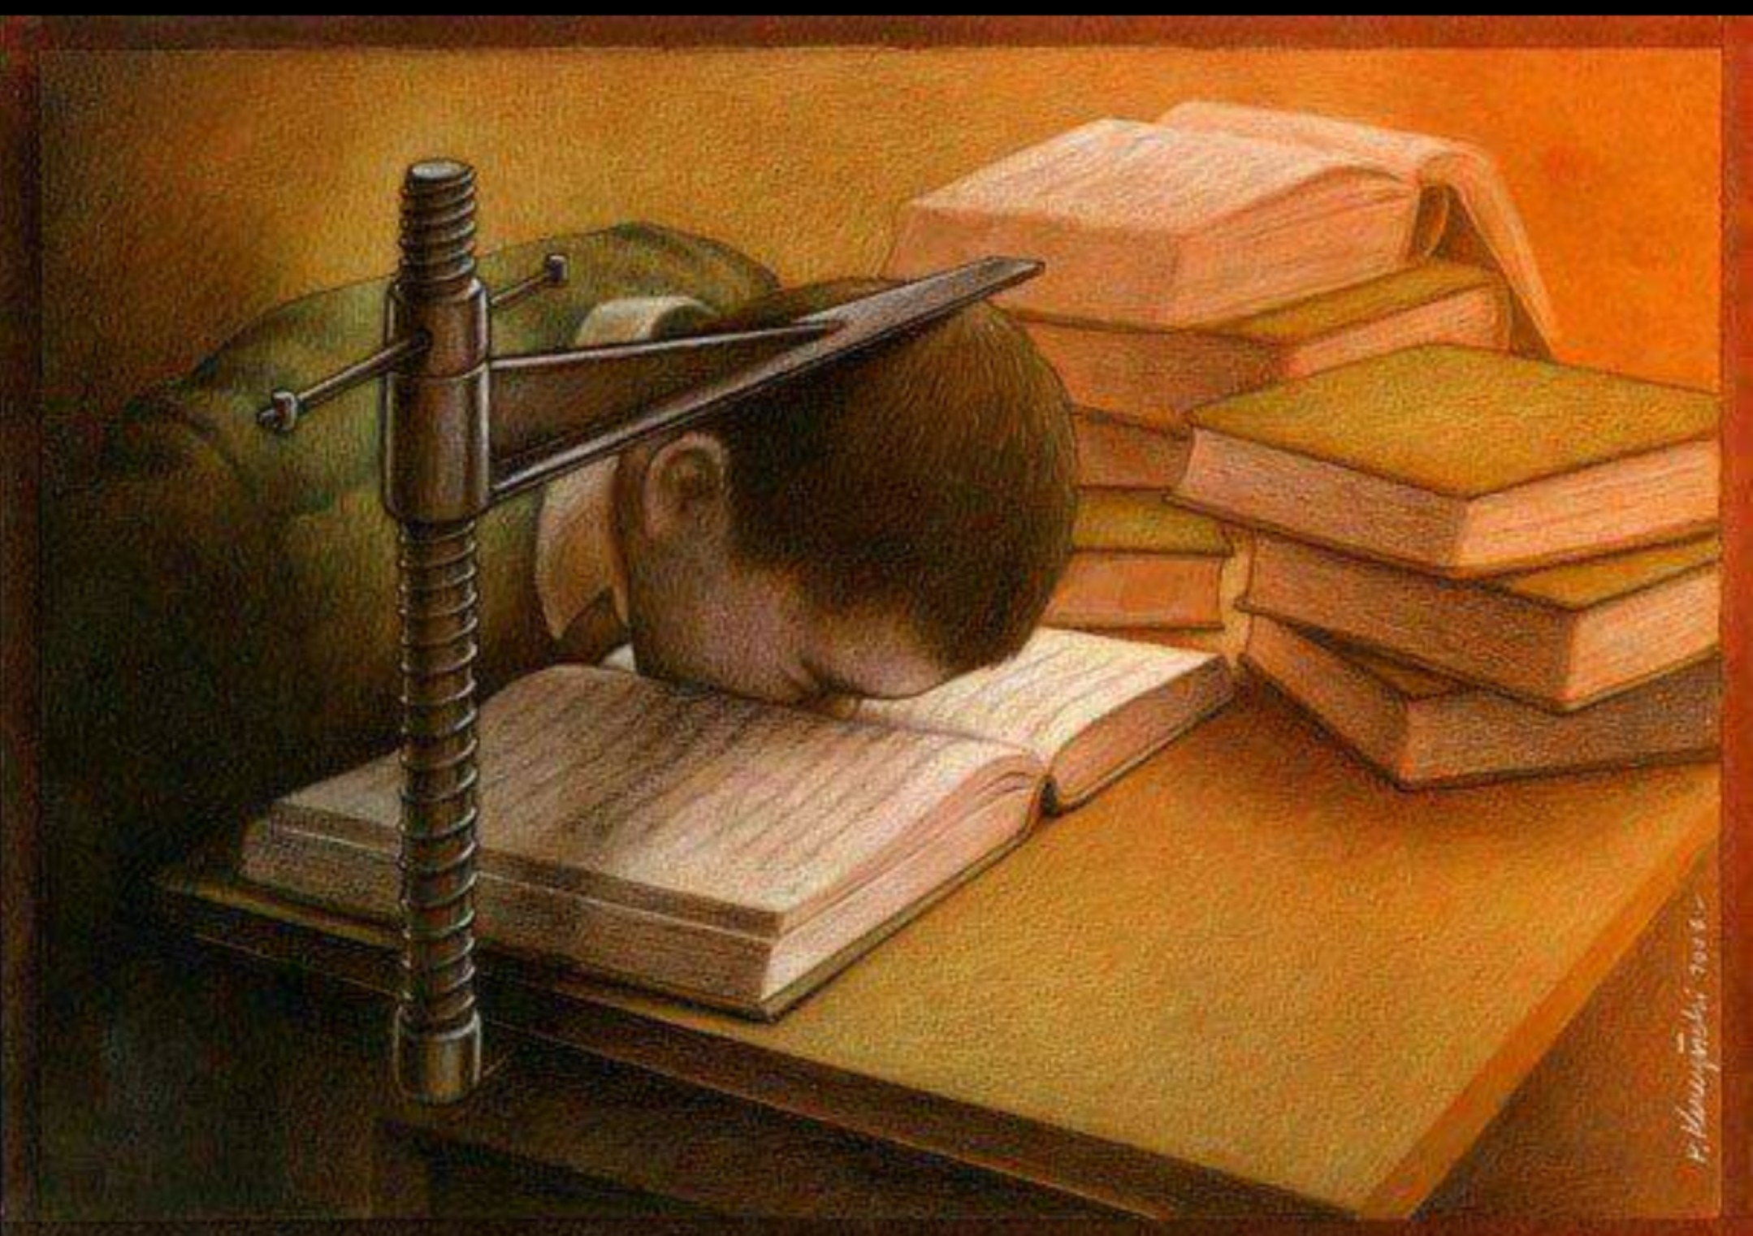
What elements do you notice in this image?
What metaphorical story is being told here?

Slide 5
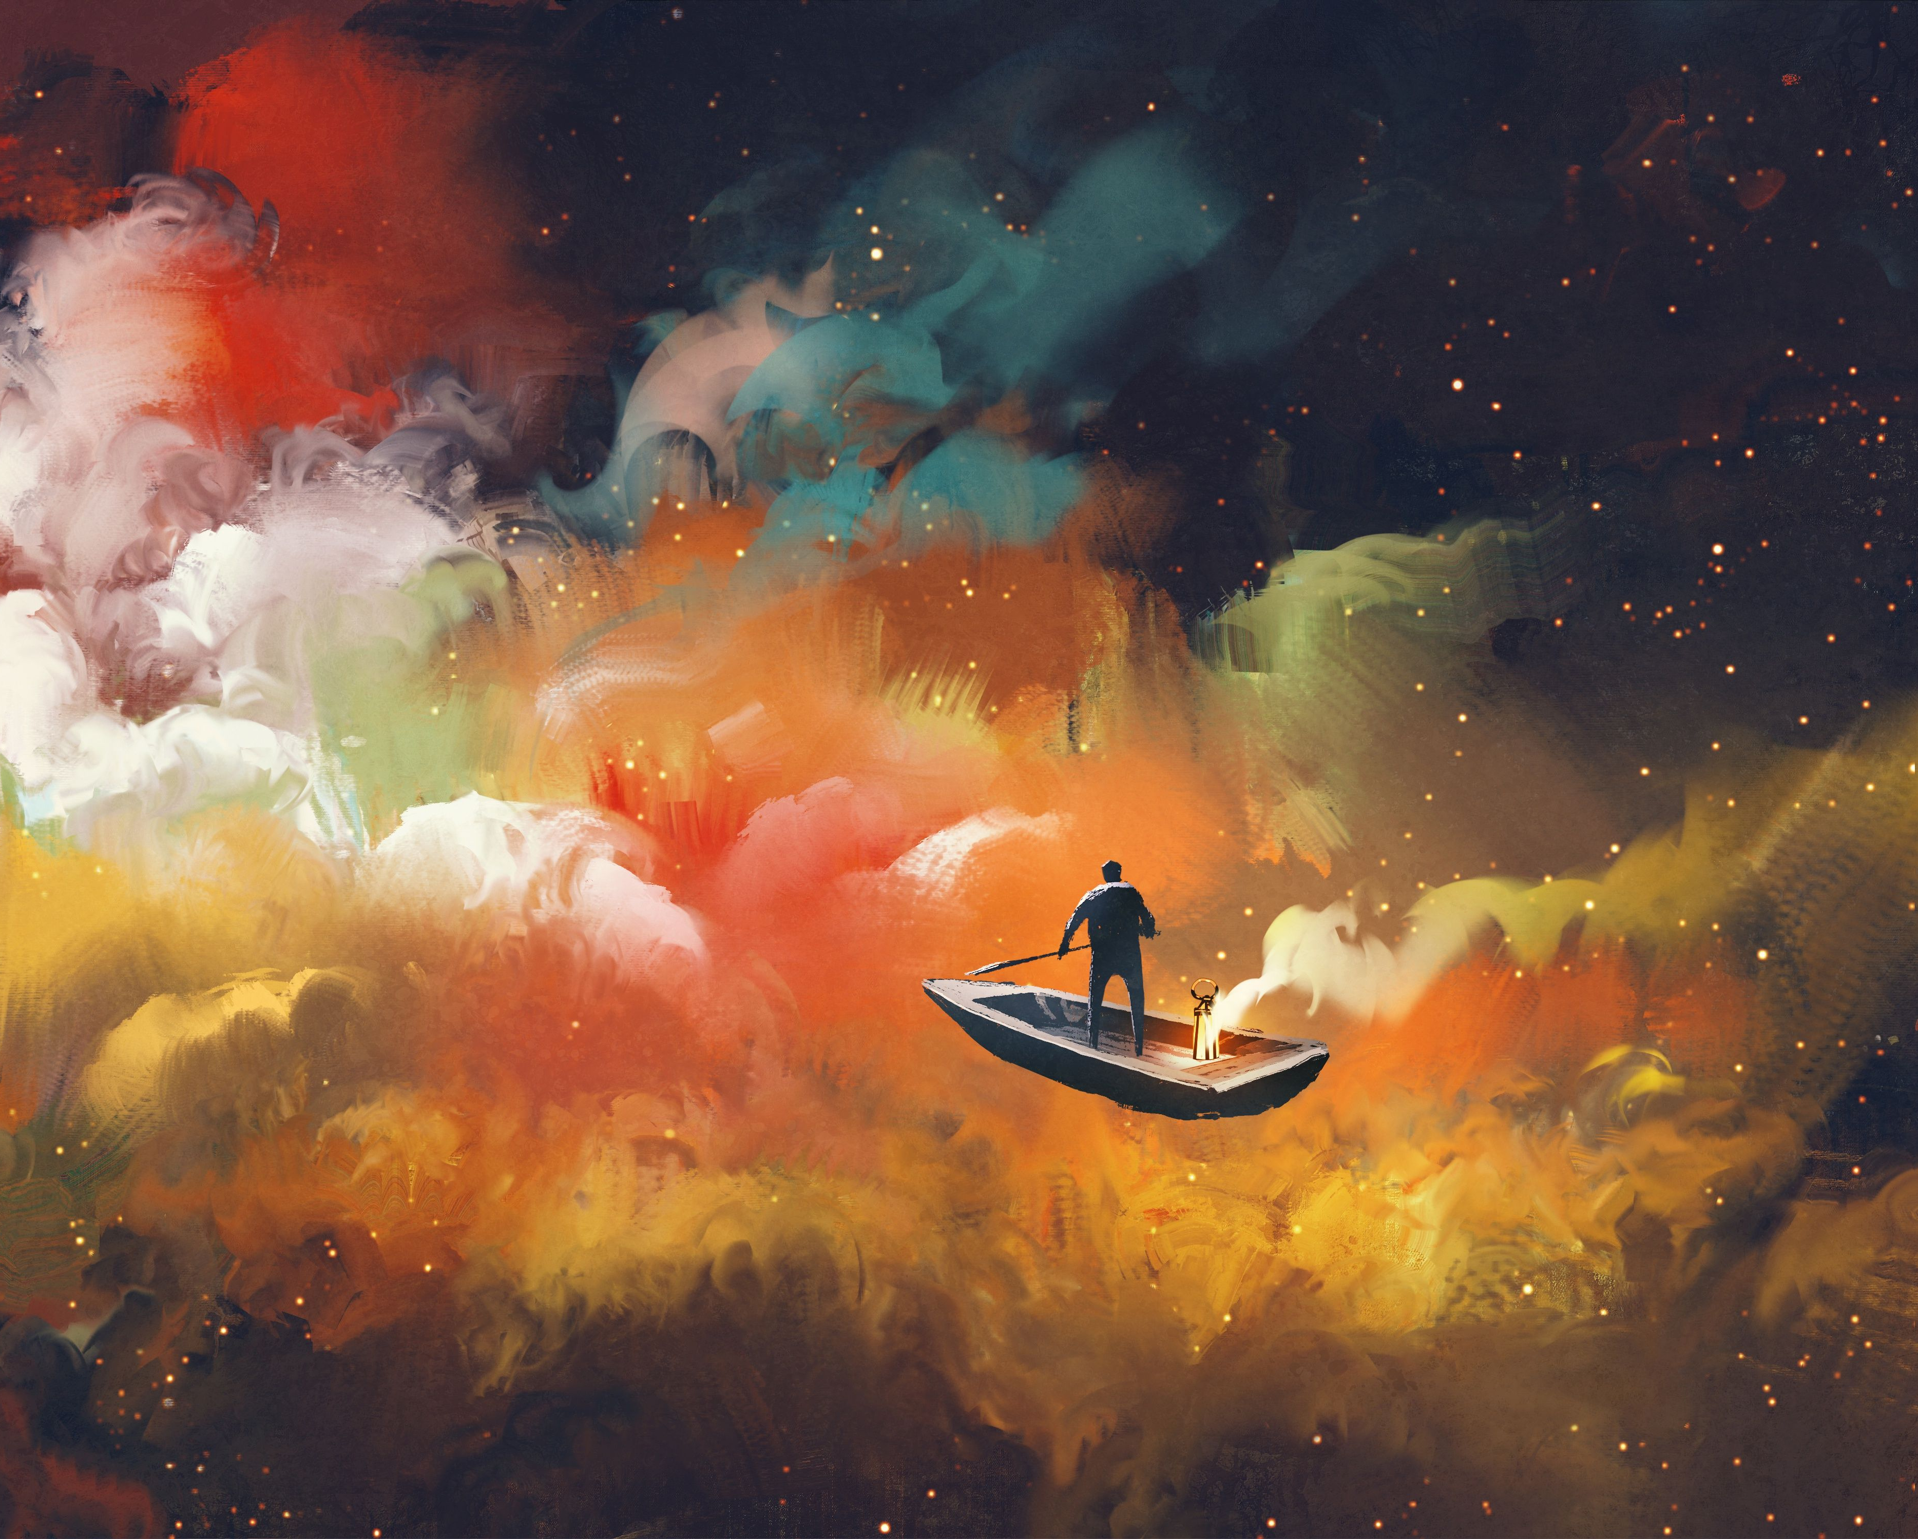
The worlds in the Peace Literacy Metaverse are similar to dreamscapes.
Exploring these worlds is similar to exploring dreams, allowing us to unlock mysteries and treasures hidden in our unconscious mind.
Everything in these worlds has a purpose, a metaphorical meaning.
Everything in these worlds tells the story of our shared humanity, in the form of allegories that you will experience.

Slide 6
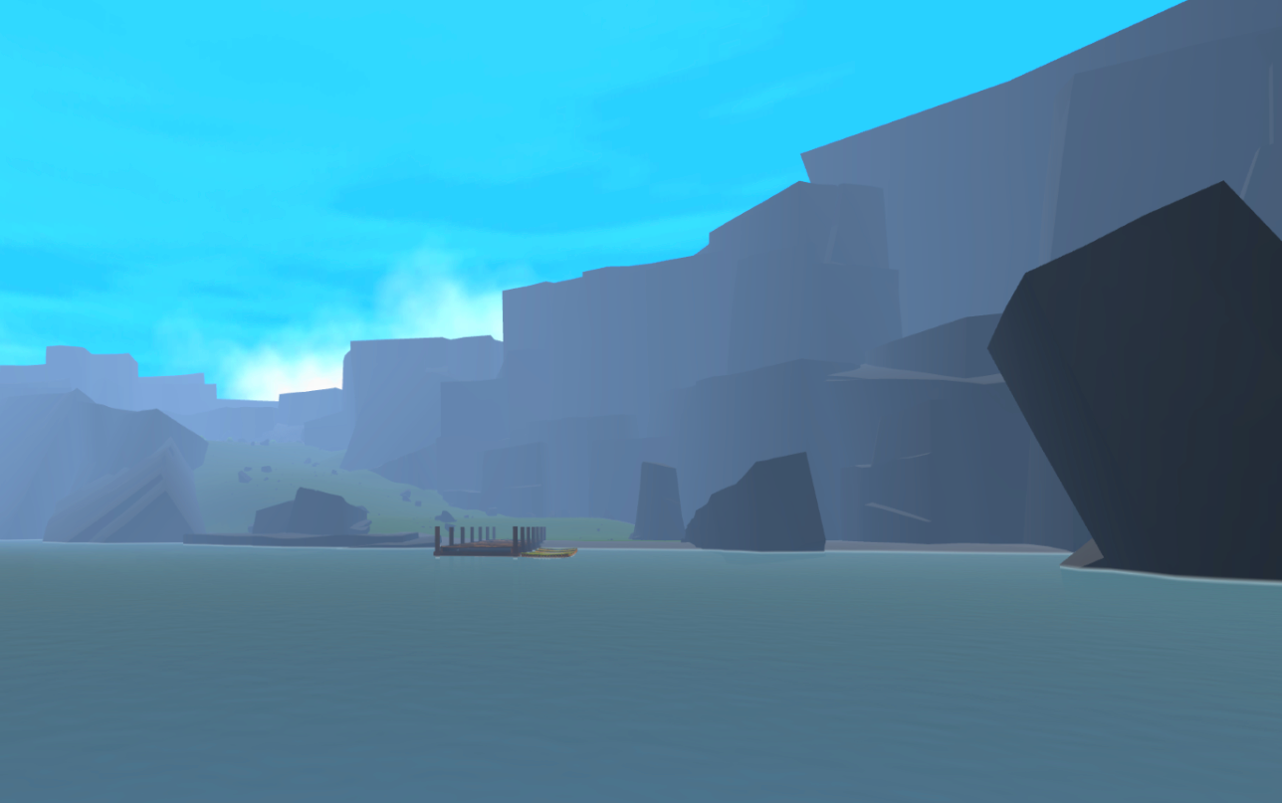
In the first world you will visit, this ocean symbolizes the Cosmic Ocean, which is a metaphor for the universe, reality.
The vast Landscape of the Human Condition — of which the Island of Aggression is a part — arises out of the cosmic ocean, the universe, reality.

